Slide 1



Inclusion by design for children and young people with Developmental Language Disorder (DLD)
For mainstream school staff
Notes:
This presentation is intended to introduce and raise awareness of Developmental Language Disorder, referred to in short as DLD.
It has been written by qualified and experienced speech and language therapists (SaLTs) at I CAN, the children’s communication charity, and reviewed by SENCos from primary and secondary mainstream settings in the UK to ensure it is appropriate and relevant for delivery to mainstream education staff.
It was commissioned by Whole School SEND as part of a package of resources and training for school staff to increase understanding of DLD and support for affected children and young people (CYP), you can find these on I CAN’s DLD webpage https://ican.org.uk/dld-webinar-series/ and also on the SEND gateway www.sendgateway.org.uk/resources - there’s a slide with these links at the end of the presentation.
Notes for presenter:
Notes under slides are points for presenter to say to audience.
Anything in italics (like this) is a note for the presenter to consider – like an optional activity or a point to be aware of.
You can vary the length of the presentation based on the amount of time you have available – our reviewers recommend that this is delivered in a twilight training session or as an INSET day.
The training could be broken up into 1 – 1.5 hour blocks if desired, with opportunities for attendees to go away and reflect in between sessions, for example:
Session 1 – What is DLD / How many CYP does it affect / Long-term impact
Session 2 – What does DLD look like in the classroom / Universal strategies to support all CYP
Session 3 – Targeted and specialist support for CYP with DLD
Optional activities are included throughout – you can either choose to do all, or some, or none of these based on the amount of time you have and the size of your group.
Delete slides as needed – you will notice a symbol in the top right hand corner of the slides that are designed specifically for primary/secondary staff.
Personalise slides based on your own setting – for example, when talking about specialist support, amend this slide to reflect the support available in your local area.

Slide 2

What we will cover
What is Developmental Language Disorder (DLD)?
How many children and young people (CYP) are affected by DLD?
Potential long-term impacts of DLD
Universal practices to support all CYP
Targeted and specialist support for CYP with DLD
How to raise concerns
Notes:
This slide shows what we will cover in this session.
The focus of this session is on raising awareness of what DLD is and starting to look at how to identify and support these children and young people at school.
It’s a complex area and there are many more resources available online – we will share follow up resources at the end.
Some staff will need to know more than what we cover today, but this is a good starting point.
We will also discuss at the end how we want to take this forward in our school.

Slide 3
Activity
Take the quiz!
DLD affects approximately what % of children in UK primary schools?
  ~1%
  ~5.4%
  ~7.6%
DLD is thought to be:
  Less prevalent than autism
  More prevalent than autism
  The same as autism in terms of prevalence
Approximately what % of children and young people with emotional and behavioural disorders have been found to have significant, often unidentified language difficulties?
  ~32%
  ~55%
  ~81%
Which of the below are possible indicators of DLD?
  Difficulty understanding language only
  Difficulty talking only
  Difficulty with talking and understanding
  Difficulty with literacy, reading comprehension and spoken language
  All of the above
Who can diagnose DLD?
  A teacher
  A SENCo
  A doctor
  An educational psychologist
  A speech and language therapist (SaLT)
Notes:
Quick quiz to begin – this is intended to be fun!
Write down your answers on a piece of paper as we’ll come back to these at the end.
You could also go through the questions and get staff to raise their hands to gauge the level of staff knowledge at the beginning of your training.

Slide 4
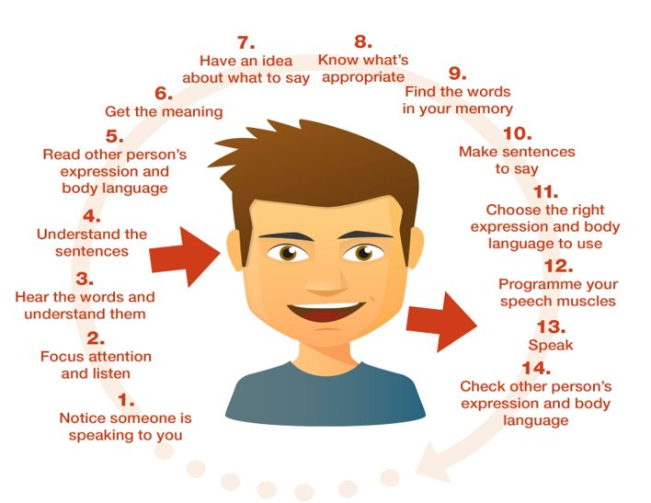
The communication chain – incredibly complex process!
Notes:
This slide gives us a simplified picture of the process of communication – even in a simplified visual it still looks incredibly complex!
We take this for granted because we do it every day.
In reality, the process is not as simplified and linear as this, but for our purposes, roughly the left hand side of the diagram shows listening and understanding and the right hand side depicts expression or talking.
CYP with DLD can have a breakdown at many different points on this chain – and often, at multiple points.
These skills all interact with one another, so a breakdown at one point in the chain will have an impact on many other parts as well.

Slide 5
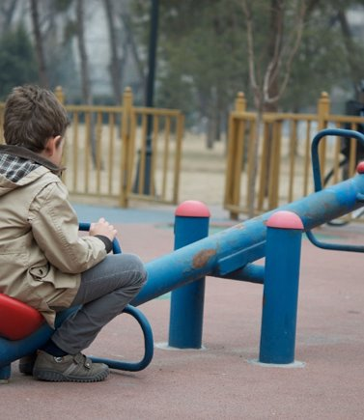
What’s in a name?
Receptive / expressive language disorder
Specific language impairment (SLI)
Language disorder
Language difficulties
Language impairment
Notes:
You may have heard some or all of these terms used to describe CYP who have difficulties understanding and using language.
It was recognised that too many different terms were being used to describe these difficulties, so the term Developmental Language Disorder was agreed by consensus amongst professionals across many English speaking countries in 2016.
The term Specific Language Impairment (SLI – top left) is now considered out of date and no longer used – DLD is used instead.

Slide 6
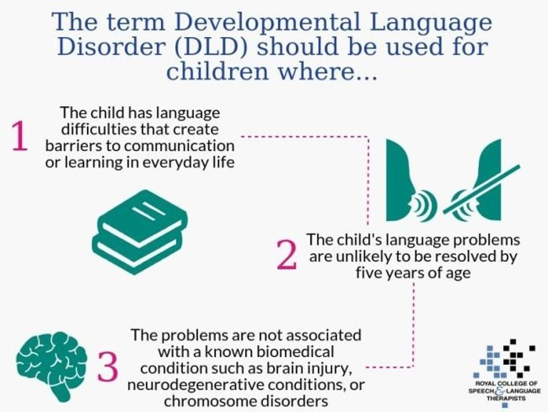
Notes:
The term DLD is used as a diagnostic term by speech and language therapists for CYP who have language difficulties that:
Create barriers to communication or learning in everyday life
Are unlikely to resolve by 5 years of age – it’s a lifelong condition
Are not associated with a known biomedical condition. CYP with some biomedical conditions such as autism or Down’s syndrome may also have a “language disorder”, but in that case it would be described as “language disorder associated with autism” or “language disorder associated with Down’s syndrome”. Developmental Language Disorder means it’s not associated with a known biomedical condition.

Slide 7
DLD in context
All children and young people
Language Disorder
Speech, language and communication needs (SLCN)
DLD
Notes:
This can be confusing! Think of it like this:
The blue circle on this slide represents all CYP
Within that group, there are some CYP who have difficulties with their speech, language and communication skills – this group is shown by the green circle. This includes CYP who stammer, or who have speech sound disorder, or CYP who are behind with their language because they haven’t had enough communication-supportive experiences when they were young.
Within the green circle of children with speech, language and communication needs, or SLCN, there is a group of children with language disorder – they are shown by the orange circle. Language disorder means lifelong language difficulties that impact communication or learning in everyday life. These children won’t grow out of it. Some of the children in this circle may have language disorder associated with a known biomedical condition like autism or Down’s syndrome.
The red circle is DLD – CYP who have a language disorder that is NOT associated with another condition. We don’t know the cause as yet but this is a life-long condition; they won’t grow out of it.

Slide 8
What is DLD caused by?
No known cause
DLD is caused by a complex interaction between genetic and environmental risk factors
The profile of risk factors will vary between individuals
These risk factors appear to have subtle impacts on the way the brain learns language
DLD can co-occur with other conditions like dyslexia or ADHD
Notes:
We don’t know the cause of DLD as yet.
Like other developmental conditions, such as dyslexia and autism, DLD is caused by a complex interaction between genetic and environmental risk factors which will vary between individuals.
There may be some differences in the brain, but they don’t show up on a brain scan.
It's often called an “invisible” or “hidden” condition because you can’t see it.
CYP can have DLD and dyslexia, or DLD and ADHD. One condition isn’t causing or associated with the other – the CYP just has both.

Slide 9
DLD is NOT caused by…
Another medical condition or diagnosis (e.g. autism, hearing impairment, Down’s syndrome)
Environmental reasons / lack of communication-supportive experiences
Poor parenting
Emotional difficulties
English as an Additional Language (EAL)
Notes:
As we said before, the term DLD is given when CYP have lifelong language difficulties that are not caused by another medical condition or diagnosis e.g. hearing loss, autism, physical impairment, learning difficulties, brain injury.
We also know it’s not caused by environmental reasons or a lack of communication-supportive experiences in early childhood. Some children do start school with language difficulties due to a lack of communication supportive experiences, but that’s not DLD. Many of those children catch up once they have the right support put in place.
It’s also not due to poor parenting – important that families know this and don’t feel they have caused their child’s difficulties.
It’s not caused by emotional difficulties – but lots of CYP with DLD do have emotional difficulties as well.
And it’s not caused by learning English as an additional language. More on next slide about this.

Slide 10
DLD and English as an Additional Language (EAL)
EAL is not SEN, SLCN or DLD
  It’s an advantage in many ways!
CYP with both DLD and EAL will have difficulties in both/all languages
Do the family have concerns about their child’s talking and understanding in their home language?
Advice for families – speak their home language to their child
Notes:
This is a complex area – we often see CYP who seem to be behind in their talking because they’re learning English as a second, or third or fourth, language.
But this is not a language disorder. It’s just the process they are going through of learning another language.
BUT if a CYP does have DLD, it will affect ALL of their languages – they’ll have difficulties in English but also in their home language.
So if you are concerned about a CYP with EAL, it’s a good idea to ask about their skills in their home language as well.
Families should keep speaking to their child in their home language – this is the language they are most comfortable in and can give the best language model to their child.

Slide 11
What we will cover
What is Developmental Language Disorder (DLD)?
How many children and young people (CYP) are affected by DLD?
Potential long-term impacts of DLD
Universal practices to support all CYP
Targeted and specialist support for CYP with DLD
How to raise concerns
Notes:
We have talked about what DLD is, now let’s talk about how many CYP are affected by it

Slide 12
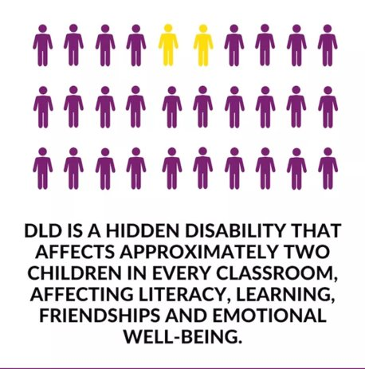
DLD is common
~7.6% of children in primary school
Norbury et al (2016)
Notes:
DLD has been called the most common childhood condition that most people have never heard of.
It affects approximately 2 children in every average primary classroom of 30 in the UK.
Analysis of data from DfE indicates that more than half of children with DLD are not being identified by schools – so that means that it’s likely we have lots of CYP in this school with DLD who haven’t yet been identified.
Can you all remember what percentage of children you said you thought had DLD in the quiz?
CLICK – the correct answer is approximately ~7.6% of children in primary schools, based on a study by Norbury and colleagues in 2016 called the SCALES study. Remember this is a lifelong condition – so children don’t “grow out” of their difficulties or “catch up” to their peers once they are in secondary school.
DLD is thought to be approximately 7 times more common than autism – yet lots of people have never heard of it.
NB: ~7.6% should appear on the screen when presenter clicks mouse
*Surrey Communication and Language in Education Study (SCALES), an epidemiological study in the UK (Norbury et al, 2016). Based on assessment of a population sample of children in state-maintained classrooms in the first few years of school. The researchers estimated the total population prevalence of language disorder to be 9.92%. The prevalence of language disorder of unknown origin was estimated to be 7.58%, while the prevalence of language impairment associated with intellectual disability and/or existing medical diagnosis was 2.34%. These estimates are consistent with previous population studies in the United States (7.4%, Tomblin et al. 1997). The researchers advise that these are estimates and precise numbers in a given community may vary depending on the diagnostic criteria and assessments employed to identify children, and the local context (estimates may be higher in areas of socio-economic disadvantage).

Slide 13
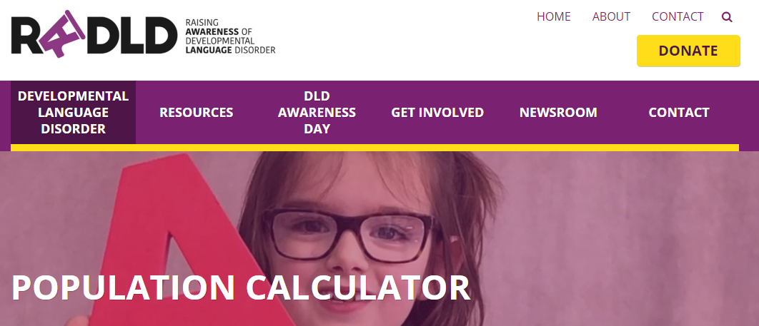
Activity
How many CYP with DLD in our setting?
https://radld.org/about/dld/population-calculator/
Notes:
Optional activity:
Cut and past this link to the population calculator https://radld.org/about/dld/population-calculator/
Enter the number of CYP at your school – the calculator will tell you the number estimated to have DLD in your school
Do you have that many identified?
You can repeat this for different class sizes to show how many CYP in each class are estimated to have DLD.

Slide 14
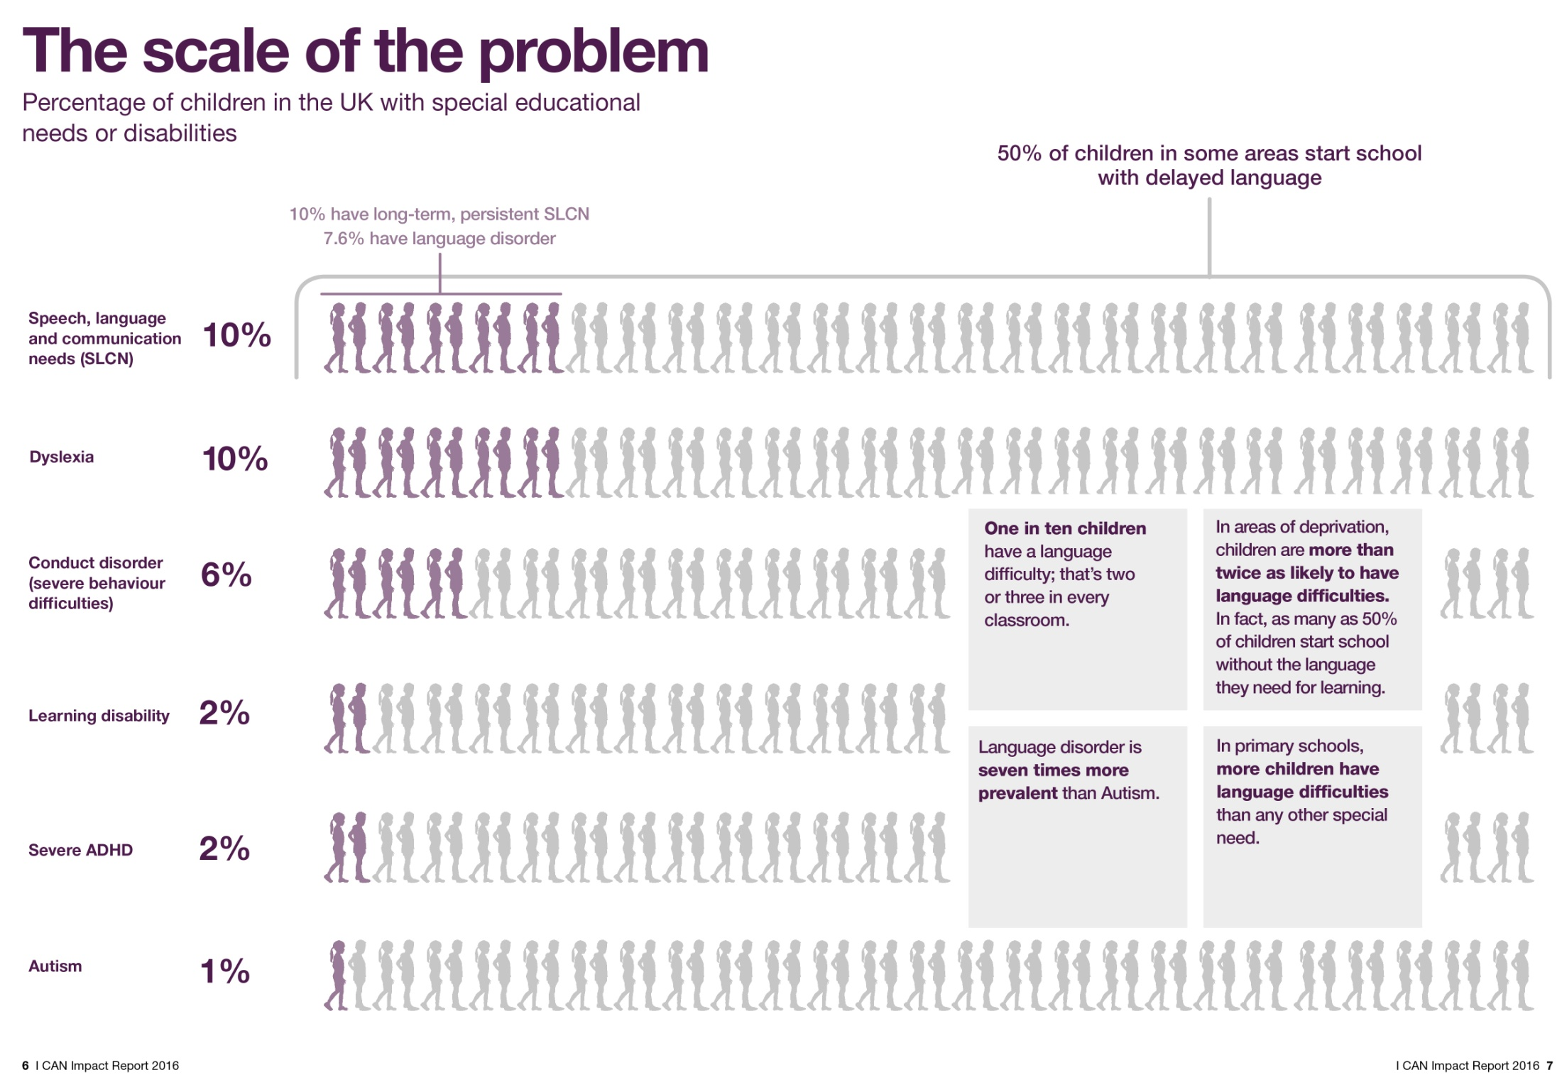
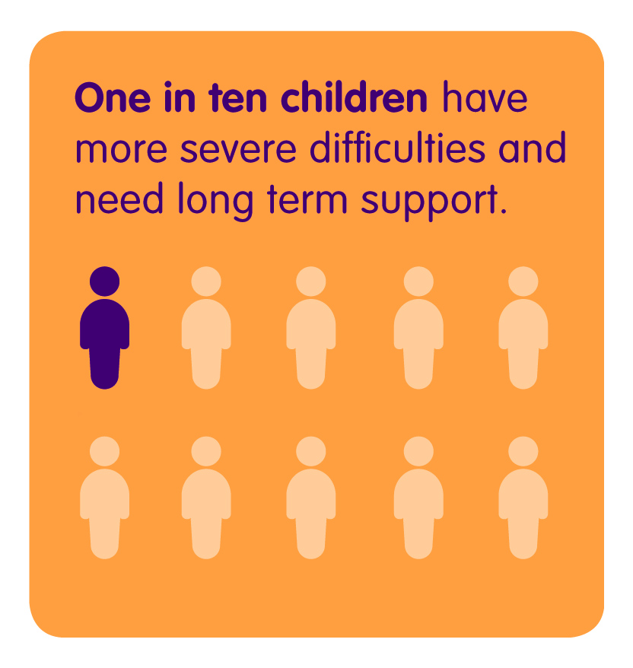
Over 50% of children in some areas start school with delayed language
~7.6% have DLD
Language disorder
Dyslexia
Conduct disorder (severe behaviour difficulties)
Learning disability
Severe ADHD
Autism
Notes:
This slide gives DLD in the context of other types of special educational need. It’s not intended to portray DLD as higher priority than others – but to demonstrate prevalence.
Approximately 7.6% of children in primary schools in the UK have DLD.
Compare these numbers to some of the other types of SEN – e.g. ADHD and ASD – much smaller % - but they are much better known.

Slide 15
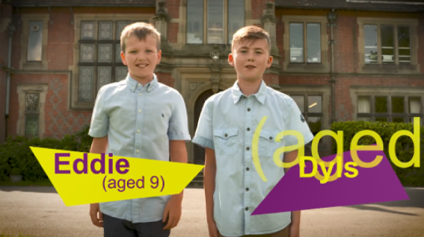
DLD 1, 2, 3
Video
Primary
https://www.youtube.com/watch?v=tQ-s02HWLb0&vl=en-GB
Notes:
Watch video (4:37 mins) https://www.youtube.com/watch?v=tQ-s02HWLb0&vl=en-GB
This video demonstrates in an accessible and entertaining way the types of difficulties that children with DLD experience every day. Its particularly poignant when the girl describes how she feels as if people are speaking a different language and she wishes that everyone would stop using big words.
Let me now ask you 3 quick questions:
Raise your hand if the children in this video reminded you of any children in your class
Keep your hand raised if they are known to speech and language therapy
Now finally, keep your hand raised if they have a diagnosis of DLD
Of course not all the children you are thinking of will have DLD – but some of them may and it’s likely that many of them aren’t identified.
Note to presenter: remember you can delete slides as needed – see the symbol in the top right hand corner of the slides that show if they are designed specifically for primary/secondary staff.

Slide 16
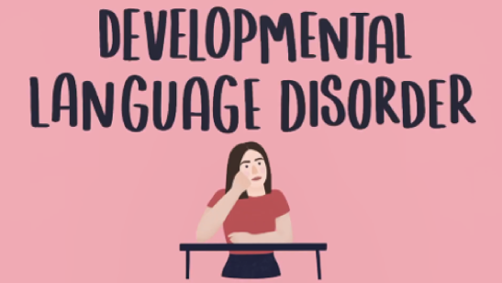
Lily Farrington’s DLD animation
Video
Secondary
https://www.youtube.com/watch?v=rwOfkj0dj_0
Notes:
Watch video (2 mins) https://www.youtube.com/watch?v=rwOfkj0dj_0
This video is helpful because she talks about how it feels for her and what her experience of it is.
She was only diagnosed at 15 – this goes to show that CYP with DLD can go undetected for a really long time – so its important for us all to be aware of the possible indicators!
Let me now ask you 3 quick questions:
Raise your hand if the girl in this video reminded you of any young people at our school
Keep your hand raised if the young people you are thinking of are known to speech and language therapy
Now finally, keep your hand raised if those young people have a diagnosis of DLD
Of course not all the young people you are thinking of will have DLD – but some of them may, and it’s likely that many of them aren’t identified.
Note to presenter: remember you can delete slides as needed – see the symbol in the top right hand corner of the slides that show if they are designed specifically for primary/secondary staff

Slide 17
What we will cover
What is Developmental Language Disorder (DLD)?
How many children and young people (CYP) are affected by DLD?
Potential long-term impacts of DLD
Universal practices to support all CYP
Targeted and specialist support for CYP with DLD
How to raise concerns
Notes:
Now we’re going to think about the potential impacts of DLD – why it matters

Slide 18
Language underlies everything we do
Reading & writing
Reading comprehension
Learning new concepts / vocabulary
Understanding explanations
Following instructions
Resolving conflicts in the playground
Following the rules of a sport/game
Negotiating with peers
Notes:
Language underlies much of what we do at school and in life, so it makes sense that CYP with DLD are going to have difficulty with a great many things.
An obvious link is the one between spoken language and reading and writing. If CYP have difficulties with any aspects of spoken language, you will notice the impact in their reading and written language as well.
Some CYP with DLD will learn how to decode so they can read aloud fluently, but this won’t get them very far if they can’t understand what they have read. Reading comprehension is likely to be affected.
CYP with DLD are also likely to have difficulty learning new concepts and vocabulary, which then impacts their learning.
They might struggle to understand your explanations and follow your instructions.
In the playground, they might struggle resolving conflicts and negotiating with peers.
Even sports and games rely on language to explain the rules – so CYP with DLD may struggle with this as well.

Slide 19

The wider impact
Friendships
Social and emotional wellbeing
Organisation
Mental health
Reasoning
Behaviour
Academic attainment
Employment prospects
Notes:
Then we see a wider impact in other areas as well, such as those shown on this slide.
They might struggle to make friends because they take longer to process what has been said and are less good at expressing themselves and keeping up in conversations.
This can be apparent in primary school, but then becomes more pronounced by secondary school, when communication between peers becomes a lot more nuanced, subtle and fast-paced.
Some may get into trouble or have conflicts with peers in the playground, but can’t explain what has happened whereas others can fluently describe incidents.
A really high proportion of CYP with DLD have mental health difficulties.
It has been found that 81% of children with emotional and behavioural disorders may have significant language deficits, often unidentified (Hollo et al 2014)
One of the problems here is that mental health support usually involves talking therapies, like counselling, which these CYP can’t access.
We also see difficulties in areas like behaviour and reasoning.
And finally language difficulties often result in lower academic attainment, and even affect employment prospects later on.
DfE GCSE results from 2019 indicate that young people with speech, language and communication needs achieved an average attainment 8 score (25.8) that was close to half that of their peers with no identified SEN (49.9) (Department for Education, 2019).
Children with poor vocabulary skills are twice as likely to be unemployed when they reach adulthood. Law, J. et al (2009)

Slide 20
Activity
What might it look like in the classroom?
  Think about…
  Attention and listening
  Behaviour
  Social interaction and friendships
  Talking
  Understanding
  Academic work – across all subjects (English, Maths, Science etc.)
Notes:
Activity – discuss in small groups and feedback. 5 mins discussion & 5-10 mins for feedback – you could either ask each group to feedback on one of the elements on this slide, or you could get each group to think about everything and then feed back a couple of the main points they talked about. Write key indicators on the board as groups feed back – then refer to the points on the next few slides to highlight the key indicators.
Now let’s think about what these CYP might look like in your classroom, so that you know how to pick them out.
Remember we said that DLD is referred to as a hidden or invisible disability – so there is no one set of criteria to use.
Think about what you MIGHT notice in the classroom though – in terms of attention, behaviour, social interaction, talking, understanding, and finally academic work.

Slide 21
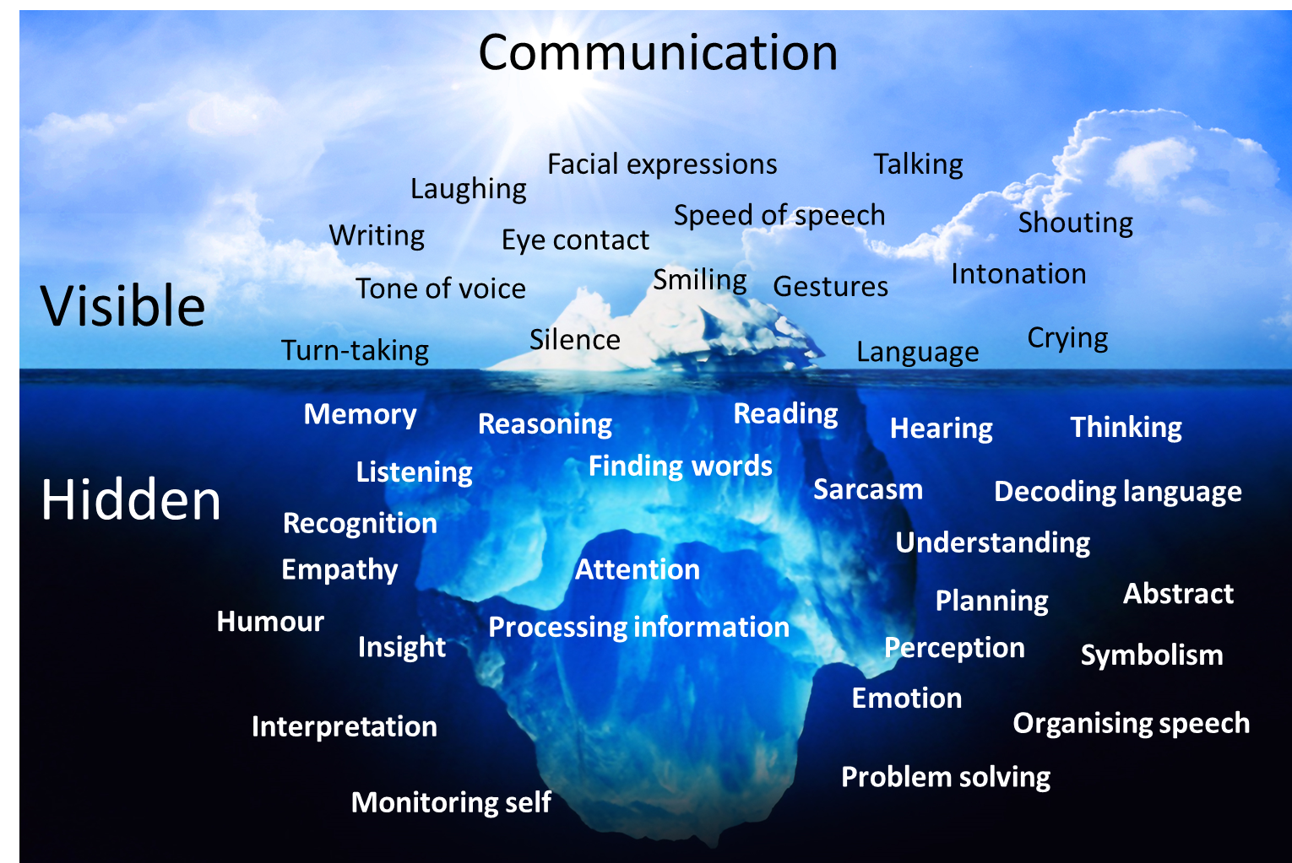
Notes:
This iceberg model is a nice way of showing what we have just been talking about – that what we see on the surface in terms of someone’s behaviour and communication may not always tell us the full picture of what is going on underneath for them.
What we notice in the classroom might just be the surface behaviours – but there might be a lot more going on underneath.

Slide 22
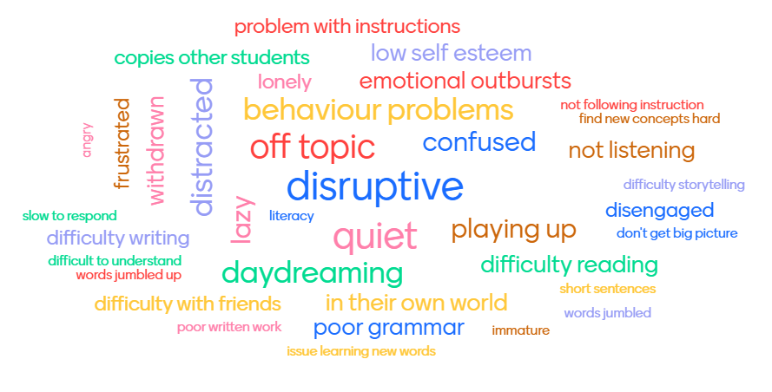
What might it look like in the classroom?
Primary
Some words that primary teachers used to describe how DLD might present in the classroom
Notes:
This slide is a word cloud that was generated by primary school teachers during an I CAN webinar in Autumn 2020. We asked them what children with DLD might present like in the classroom and this is what they told us. Talk through this based on your discussion already – some extra notes below to discuss further.
This word cloud has a few of the key indicators or behaviours that you might notice in your classroom.
It’s a word cloud that was generated by primary school teachers during an I CAN webinar in Autumn 2020 when asked “how do you think children with DLD would present in the classroom?”
Often children with DLD have poor attention – this can be described as not listening, staring out the window, blank, in their own world.
Or, they may become disruptive and act out.
Some may get into trouble or have conflicts in the playground, but can’t explain what has happened whereas others can fluently describe incident.
Often they might seem to just be one step behind where the other kids are in a social situation – and so because of that they struggle with friendships.
Note to presenter: remember you can delete slides as needed – see the symbol in the top right hand corner of the slides that show if they are designed specifically for primary/secondary staff

Slide 23
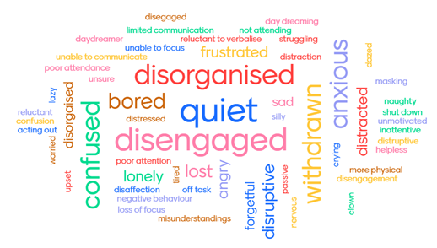
Secondary
What might it look like in the classroom?
Some words that secondary teachers used to describe how DLD might present in the classroom
Notes:
This slide is a word cloud that was generated by secondary school teachers during an I CAN webinar in Autumn 2020. We asked them what DLD might present like in the classroom and this is what they told us. Talk through this based on your discussion already – some extra notes below to discuss further.
This word cloud has a few of the key indicators or behaviours that you might notice in your classroom.
It’s a word cloud that was generated by secondary school teachers during an I CAN webinar in Autumn 2020 when asked “how do you think children and young people with DLD would present in the classroom?”
As we said, DLD is often described as an “invisible” or “hidden” disability. Particularly if it hasn’t been picked up at a younger age, it can be easy to mistake for a behaviour problem once young people reach adolescence.
Conversely, sometimes these young people have learned lots of masking behaviours by secondary age, and so they might present as very quiet and compliant.
Often they might seem to just be one step behind where the other kids are in a social situation – and so because of that they struggle with friendships.
Note to presenter: remember you can delete slides as needed – see the symbol in the top right hand corner of the slides that show if they are designed specifically for primary/secondary staff

Slide 24
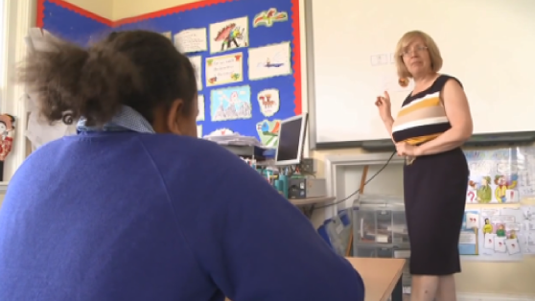
What might it look like: video
Video
https://www.youtube.com/watch?v=JAsf_Wqjz4g
Notes:
Watch video (7:10 mins) https://www.youtube.com/watch?v=JAsf_Wqjz4g
If you want to reduce the length you could play from the beginning up to 4:36)

Slide 25
What we will cover
What is Developmental Language Disorder (DLD)?
How many children and young people (CYP) are affected by DLD?
Potential long-term impacts of DLD
Universal practices to support all CYP
Targeted and specialist support for CYP with DLD
How to raise concerns
Notes:
So, now let’s talk about how we can best support these CYP in our school.

Slide 26

Roles and Responsibilities
SEND is EVERYONE’S business
Teachers responsible for students’ progress
Families need to be informed and involved
Notes:
Its important for us to remember that under the Code of Practice, SEND is everybody’s business.
Teachers are responsible for students’ progress – so even if they have additional support from other adults, it is important to know what is going on and to be planning that student’s education, when they have time for additional support and interventions, monitoring their progress, etc.
That means we all need to know how to identify and support CYP with DLD.
We also need to remember to involve families – be aware that other family members may also struggle with aspects of communication and language (although this is not always the case).

Slide 27
A graduated approach to support
Specialist
Targeted
Universal
Applies to CYP with the most complex SLCN, including DLD, who require the highest level of support
Applies to some CYP some of the time – including those with DLD but also those with less significant needs
Applies to all CYP (including DLD)
Notes:
Let’s think about the support that we can give CYP with DLD according to this model – a graduated approach.
Universal- applies to all CYP. Any strategies put in place at this level benefit all CYP, including those with DLD. This encompasses inclusive high quality teaching – ensuring that we’re using communication supportive practices all the time to benefit the speech, language and communication skills of all CYP.
Targeted - applies to those CYP are struggling a bit and need a higher level of support. They may benefit from small group work, environmental modifications and additional targeted adult strategies to help them access learning. CYP with DLD will benefit from support at this level as well, it’s just that they will often need more support on top of this.
Specialist - applies to those CYP with the most complex needs who require the highest level of support. This includes CYP with DLD – although CYP with DLD won’t always get support at the specialist level. It includes support from external agencies like speech and language therapists or specialist advisory teachers.
This pyramid shows us that what works for CYP at the universal level will also support CYP needing more specialist support - a good, whole setting approach to supporting CYP’s speech, language and communication also supports CYP all the way up the pyramid.
Today is just an introduction – there is lots we could do across all of these levels, but today we will just introduce a couple of key ideas for each.

Slide 28
Primary
Notes:
NOTE TO SENCOS: THE FOLLOWING SLIDES ARE AIMED AT PRIMARY SETTINGS. IF LOOKING FOR SECONDARY SLIDES, PLEASE DELETE THESE SLIDES MARKED “PRIMARY” AND SCROLL THROUGH TO SECONDARY SLIDES LATER IN THIS PRESENTATION.

Slide 29
What does “Universal” look like?
Universal
Primary
We understand what DLD is and the impact it can have on learning and behaviour
We all use communication-supportive strategies all the time
Teaching supports all children’s speech, language and communication
We have tools to identify children who have speech, language and communication needs
Notes:
To have good universal provision for all children, we need these things.
We all need to know what DLD is and why it’s important – and today is the start (but not the end!) of that.
We all need to be using communication supportive strategies all the time – we’ll talk about those in a minute.
We need to make sure that our teaching practices support the speech, language and communication skills of all children – those with DLD as well as those without.
We also need to make sure that we have tools to help us identify children who are having difficulties, and who have possible DLD.

Slide 30
Some universal strategies
Primary
Specialist
Targeted
Universal
Create a communication-supportive environment
Adapt your language
Explicitly teach vocabulary
Notes:
We’re going to talk about 3 key strategies that can be applied at the universal level now.

Slide 31

Strategy 1: Create a communication-supportive environment
Universal
Primary
  Reduce background noise
  Plan and use visual supports, such as:
    Pictures, symbols, diagrams, mind maps
    Visually label classroom resources
    Write down key information and instructions
    Highlight/underline/bold key words
    Use a visual timetable
  Reduce classroom clutter
  Encourage asking for help
Notes:
One way of supporting the speech, language and communication skills of all children is to have a communication supportive environment. Some examples of how to do that are given on this slide.
Reduce background noise – this helps children attend to what you are saying without having to filter out additional noise. You could do this by closing doors and windows, and ensuring only one person is speaking at a time (adjust this based on policies/procedures in your setting).
Plan and use visual supports to explain key concepts - like pictures, symbols, graphs, diagrams, and mind maps.
Visually label classroom resources with words as well as photos/symbols/images.
Write down key information and instructions at the front of the class. Highlight/underline/bold key words or put them in a different colour.
Use a visual timetable or write on the board the activities for the day or the lesson so that children know what to expect. Refer to it and update regularly by removing tasks when completed.
Reduce classroom clutter to support attention and reduce the need for children to filter out distractions.
Create a safe and supportive environment where asking for help is encouraged – children need to be praised when they ask for help or indicate that they don’t understand something. If a child does ask a question or asks you to repeat something, respond positively and praise them rather than viewing it as a sign that they were distracted or were not paying attention.

Slide 32
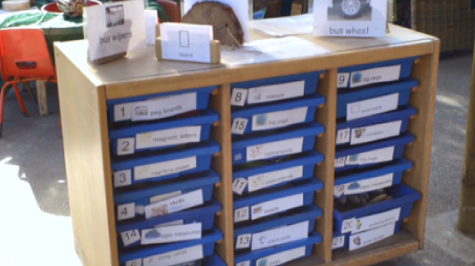
Strategy 1: Create a communication-supportive environment
Universal
Primary
Video
https://www.youtube.com/watch?v=r1ZbRpU9jak
Notes:
Now we are going to watch a video of a key stage 1 communication supportive setting
While watching, think about the strategies you can see the practitioners using and the visual supports on display and consider how these make the environment communication supportive
Watch video (3:19 mins): https://www.youtube.com/watch?v=r1ZbRpU9jak

Slide 33
Strategy 1: Create a communication-supportive environment
Universal
Primary
Activity
  Discuss in year groups/key stages:
    What examples did you notice that make the environment communication supportive?
    Which do you already have in place and which could you add to your class?
Notes:
After video, split attendees into groups based on year group/key stage and discuss the following questions as a group (with 5 mins for each group to feed back a couple of key points from their discussion/what they are going to take forward at the end):
What examples did you notice that make the environment communication supportive?
Which do you already have in place and which could you add to your class?
Examples
Visuals on display
Visual timetable
Key resources labelled – written word and photo
Key areas in classroom labelled
Practitioners use strategies like reducing background noise, teaching active listening, asking open-ended questions to support language and communication.

Slide 34
Strategy 2: Adapt your language
Universal
Primary
  Attract attention first – say their name
  Give simple instructions
  Use familiar vocabulary
  Short and simple sentences
  Slow down and pause often – give extra thinking time
  Repeat key points and summarise at the end
  Show them – write/draw/demonstrate
Notes:
Another universal strategy which is very simple but often overlooked is adapting your language to make it accessible for all children.
We often don’t realise the length of sentences or complexity of words we are using.
This might be fine for some children to understand but it’s important that ALL children in the class can understand you – not just a select few.
Some key ways of adapting language are given on this slide.
Attract attention first – agree a signal that indicates the need for whole class attention or for instructions to specific individuals. Say children’s names before giving them an instruction.
Give simple instructions – one idea at a time. For younger children, give instructions in the order you want them to follow and avoid abstract words like before and after. For older children, explain any abstract terms you are using.
Use familiar vocabulary that you know children will understand. Explicitly highlight when you have used a new or less familiar word, and check for understanding.
Use short sentences and do not talk for too long at any one time.
Give extra thinking time and processing time – go slow and pause often.
Repeat key points and summarise at the end.
And finally use visuals – we talked about this under communication supportive environment but it is really important. Having a visual cue gives something extra to help children understand – plus a visual lasts longer than a spoken word.

Slide 35
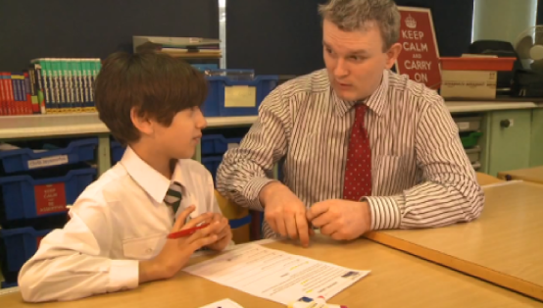
Universal
Primary
Strategy 2: Adapt your language
Video
https://www.youtube.com/watch?v=MNf-VHzClPE
Notes:
Now we are going to watch a video about adapting language.
While watching, think about the strategies for adapting language and reflect on your own language use today
Watch video (3:23 mins) https://www.youtube.com/watch?v=MNf-VHzClPE
NB: advise participants that they use the term SLI in the video because it came out before DLD was formulated as a term. We would now interpret this as DLD – all children who got a diagnosis of SLI in the past would qualify for a diagnosis of DLD.

Slide 36
Universal
Primary
Strategy 2: Adapt your language
Activity
  Discuss in year groups/key stages:
    What examples of adapting language did you notice the teachers using in the video?
    Which of these do you feel you use already?
    Which could you introduce into your practice?
Notes:
After video, split attendees into groups based on year group/key stage and discuss the following questions as a group (with 5 mins for each group to feed back a couple of key points from their discussion/what they are going to take forward at the end):
What examples of adapting language did you notice the teachers using in the video?
Which of these do you feel you use already?
Which could you introduce into your practice?

Slide 37
Strategy 3: Explicitly teach vocabulary
Universal
Primary
Tier 2 vocabulary
Describe
Discuss
Explain
Summarise
Compare
Predict
Estimate
Explicitly teach topic vocabulary and “tier 2” vocabulary
Concrete examples
Create opportunities for children to practise new words
Visual prompts and supports
What it means AND how it sounds –
  Link to other words and topics they already know
  What sound it begins with, number of syllables, words it sounds like
Notes:
General principles for teaching vocabulary to benefit all children:
Explicitly teach topic vocabulary – at the beginning of a new topic. And review it often.
It’s important to teach Tier 2 vocabulary - Tier 2 words are commonly used across a variety of subjects and yet often don’t receive as much attention as Tier 3 ‘topic’ vocabulary. Tier 2 words can often be found in the learning objectives that we use with children – e.g. explain, summarise, discuss – without which it’s difficult for them to understand what they’re meant to be doing.
Use concrete examples to help children understand the meaning.
Create opportunities for children to practise new words – use the word in a sentence, give a definition, write it, repeat it
Visual prompts and supports – pictures, diagrams etc. Have key topic vocab stuck up around the class. Refer to it often – visual supports can quickly become obsolete if they aren’t used and referred to often.
Talk about meaning AND sounds
Meaning – link to other words they know e.g. if teaching science equipment like ”test tube” or “beaker”, link it to other similar equipment. Make explicit links between words that sound the same but have different meanings etc.
Sounds – explicitly talk about what sound it begins with, syllables, rhyming words.

Slide 38
Universal
Primary
Strategy 3: Explicitly teach vocabulary
https://ican.org.uk/no-pens-day-wednesday/
Notes:
An example of a vocabulary teaching template, you can access this and other resources from the No Pens Day Wednesday section of the I CAN website https://ican.org.uk/no-pens-day-wednesday/

Slide 39
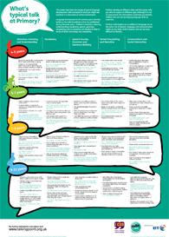
Identification tools
Primary
Universal
Activity
https://www.thecommunicationtrust.org.uk/media/1590/primary_milestone_poster_-_final.pdf
Notes:
Whilst these universal, good, high quality teaching strategies will support children’s speech, language and communication development, for children with DLD they are unlikely to be enough.
As you use these strategies in your teaching you will be able to spot which children are struggling with speech, language and communication, but it can be hard to tell what area they are struggling with or how behind they are.
This is one example of a free identification tool that can be used to check a child’s speech, language and communication development against what is expected for their age.
ACTIVITY: 5-10 mins
Use this link to open the poster in a separate window: https://www.thecommunicationtrust.org.uk/media/1590/primary_milestone_poster_-_final.pdf
Split participants into groups based on year group/key stage – participants to look at the relevant age group and consider whether children in their class are at this level. Do any of the norms surprise participants? Are there children who are perhaps not where we would expect them to be for their age?

Slide 40




Universal
Primary
Identification tools
Activity
https://www.spelfabet.com.au/2014/01/language-for-learning-checklist
Grammar and Phonology screen http://hvdl.org.uk/gaps/
Class observation
Notes:
These are some other examples of tools that can be used to identify children with speech, language and communication difficulties. The tools are not intended to be used to diagnose DLD, but they could give you an indication of children who may be struggling with their speech, language and communication skills, and who may need some extra support.
We have just spent some time looking at the “What’s typical talk at primary” poster.
Universally speaking is a similar tool – free to download, gives an indication of what children should be doing at different ages – you can check your observations of children against what is expected for their age.
Progression tools – not free, but available across age ranges up to 18 – these can help with identification but also provide a clear means of monitoring progress.
Talking point website- has a free progress checker that can be used up to age 11. Go online, select the age of child, then answer a few yes/no questions about their understanding and use of language. At the end it tells you whether they are within normal limits for their age or if you should seek another opinion.
I CAN have a free help line you can phone for advice – to discuss concerns with speech and language therapist 020 7843 2544.
Language for learning checklists are freely downloadable behaviour checklists that you can use to guide your observations .
GAPS assessment – grammar and phonology screen – 10 min screen, available for free download, but only for use up to 6 ½ years.
Finally, we can use our observation skills – but it’s important to keep a record of these – we can use this information if making a referral to speech and language therapy.
It’s important to be cautious when relying on observation only, because often children may have developed strategies to help them cope in the classroom – e.g. they might be following other children and copying what they do even though they don’t understand. So sometimes it might not look like language – but if you have concerns in some of the other areas we have talked about, it might be worth using one of these other tools to check out their language.
Also we might have noticed from the last activity (What’s typical talk) that we aren’t always 100% aware of what children should be doing at different ages – so it can help to have a tool to guide our observations.
ACTIVITY
Option 1: split into groups based on year group/key stage and talk about which of those observation tools you want to use in your class and how you will use them.
Option 2: discuss as a whole group which tools we want to use in our school and how we will use them.

Slide 41

Primary
How do I raise concerns?
Discuss with SENCo
Discuss with families
Put targeted support in place – monitor progress
Refer to speech and language therapy
Notes:
NOTE: Reorder the first two points on this slide based on what the process is in your setting. Add any additional points as applicable.
Let’s say now that you have used an identification tool and you think a child is presenting with some speech, language and communication difficulties. What next?
You would come and discuss it with SENCo to talk about options – which targeted interventions are available, what additional support can be put in place.
Raise the issue with families – the Code of Practice states that families need to be informed and involved. This needs to be done sensitively
Some families may be unaware that their child’s speech, language or communication development is delayed – you may be the first person who raises this with them.
Some families may be at different stages of their acceptance of these needs.
You may need evidence to show families e.g. written observations, recordings etc
Trial putting some targeted support in place – e.g. intervention groups, extra support in class – and monitor progress. If no progress is made this may be a sign to refer on. You can include information about support in place already and your observations in the referral. You must have parental permission to refer to the speech and language therapy service.
The next step would be referral to speech and language therapy and/or the advisory teacher service – specialist level.
Let’s discuss targeted approaches in more detail first.

Slide 42
What does “targeted” look like?
Targeted
Primary
We have additional interventions that have an evidence base and that we can deliver to small groups or individually
We have additional strategies that we can put in place in the classroom for children who need them
We measure progress by collecting outcomes
Notes:
Now we’re going to talk about targeted support.
Support at the targeted level may include additional interventions – groups or 1:1 intervention programmes that we have on offer at our school (next slide).
It may also include additional strategies that can be put in place in the classroom.
It's important when putting targeted support in place that we measure how effective it is by collecting outcomes.

Slide 43



Targeted interventions
Primary
Targeted
Specialist
Targeted
Universal
Notes:
NOTE: personalise this slide based on the interventions you have on offer in your school. We have put some of the I CAN interventions here for reference:
Primary Talk is a universal programme – supports the communication development of all children, including (but not only) those with SLCN.
Talk Boost programmes are examples of targeted interventions with published evidence. Children with delayed language will often make good progress with these programmes. Those that don’t – may have something else going on and should be referred for specialist support. So putting them in a group like Talk Boost could be a way of seeing whether they need further specialist support – if they don’t make progress it’s a sign to refer on.
You may have additional/different interventions at your school, so put them on here and discuss them. Remember a universal intervention is something delivered at the whole class level which benefits all children – and a targeted intervention is for specific groups or individual children who need extra support.

Slide 44
Some targeted strategies
Primary
Targeted
Specialist
Targeted
Universal
Differentiate work and activities
Scaffold and support spoken language
Support friendships and social interaction
Create a communication-supportive environment
Adapt your language
Explicitly teach vocabulary
Notes:
We’re going to go through 3 key strategies you can use at the targeted level now.
Sometimes the difference between universal good, high quality teaching and targeted strategies is not always clear. The differences are in the amount of personalisation in the use of targeted approaches. The strategies discussed here should be matched closely to the needs of the individual child as highlighted by the identification tool you have used. So for example if a child has problems with putting ideas in order to tell a story, using a visual framework will help. It's also an important component of targeted strategies that you evaluate how they are working for the individual child you are using them with, for example, make a note of what Blank Level the child is able to respond to at the start of term and again at half term after working on supporting their understanding of questions.

Slide 45
Strategy 1: Differentiate work and activities
Targeted
Primary
Differentiate spoken and written work based on language abilities
Simplify questions
Pre-teach vocabulary and use more visuals
Less text, more images/diagrams/symbols
Use narrative frameworks/visual structures
Help children to organise their thoughts for written tasks
Give a sentence starter and/or a list of conjunctions
Differentiate homework too!
Provide multiple options for children to demonstrate learning
Notes:
First strategy – differentiation. We need to think about how to make work accessible for children who have DLD.
Differentiate spoken and written work based on children’s language abilities. Children who only use and understand very simple sentences won’t be able to read a long paragraph and respond to comprehension questions. They might instead need a simple picture with some wh- questions to respond to.
Be aware of the complexity of your questions. A child who can’t respond to a “why” question verbally won’t be able to answer questions that require reasoning and inferencing in a reading comprehension activity. More about questions in next couple of slides.
Part of differentiation could be pre-teaching vocabulary, and then having a vocabulary list or visual support for children to refer to. Children with DLD need many more exposures to learn new words. Teach vocabulary to children with DLD before the rest of the class so that they are familiar with it – and repeat it more often.
Use more visual supports – symbols, cue cards (e.g. colourful semantics cue cards), pictures and images should be used to support their understanding and written expression.
Be aware how much text is on a written worksheet or in a textbook. Children with DLD will need more images, diagrams and symbols to break up written information. Highlight/bold/underline key words and information.
Support written language using narrative frameworks and visual structures – for example, three boxes for the child to write a sentence about the beginning, middle and end of a story. More about frameworks on next slide.
Help children with DLD at the planning stage of written tasks to organise their thoughts and work out where to start/what to do first. Some children may benefit from having an adult scribe for them at this stage – write down everything the child says about the topic initially, and then help them to look back and edit the vocabulary, sentence structure and grammar.
Give them a sentence starter (a few words to get them going) if they have trouble starting written work, e.g. “I think that…”, “I disagree with… because”.
Provide a list of conjunctions and ways they can be used to help extend their sentences when writing e.g. to continue the same point use words like “and”, “then”, “so”, “later”, “soon”. To disagree with a point use words like “but”, “however”, “except”.
Don’t forget to differentiate homework as well. Opportunities for “talking homework” with families may be more valuable for children with DLD than a written comprehension task.
Provide multiple options and scaffolding to help children demonstrate their learning – things could be written, spoken, drawn, demonstrated – or a combination of all of these. Can they explain their ideas to an adult who can scribe for them?

Slide 46
Targeted
Primary
Visual frameworks
First…
Provide visual structures / templates to help structure written work
Next…
Last…
Notes:
An example of a visual structure or template that could be used to help a child with DLD to structure their written work. This could be something as simple as 3 boxes on a piece of paper.

Slide 47
Targeted
Primary
Blank’s levels of questioning
Level 4: Analysing & reasoning
How could he…?
Why…?
What will happen if…?
What will happen next?
Level 3: Stories and events
Tell me how to…
What is a… (definition)?
Level 2: More detailed here and now, describing things
Find something that is a fruit
What’s happening?
How are these different?
Find one like this
Level 1: Here and now
Where is X?
What’s that?
Who is it?
Notes:
One model of the hierarchy of questions – by Marion Blank – is shown on this slide.
Level 1 questions relate to the here and now. Very simple, relate to things in immediate environment. E.g. what’s that, find one like this, who is it, where is X?
Level 2 questions are still about the here and now but are more detailed, more about describing things. E.g. what’s happening, find something that is a type of… , how are these different from each other?
Level 3 relates less to the here and now and is more about stories and events. E.g. tell me how to make a sandwich, tell me what a cow is (giving a definition), what might happen next?
Level 4 is the most complex, requires child to analyse and reason. E.g. How could he do this/what could he do, what will happen if…, why is/isn’t…
If you are asking rest of class questions from level 3 for example, a child with DLD might need questions from levels 1 and 2. Think about how complex the questions you are asking them are and what is realistic for them to answer.
References:
Blank, M. (2002).
Blank, M., Rose, S. A. & Berlin, L. J. (1978)
Blank, M. & Sheila, J. (1986).

Slide 48
Targeted
Primary
Practise differentiating your questions
Activity
Level 4: Analysing & reasoning
Choose a book that you are currently reading in your class
How could he…
Why…
What will happen if…
What will happen next?
Level 3: Stories and events
Tell me how to…
What is a… (definition)
Level 2: More detailed here and now, describing things
Find something that is a fruit
What’s happening?
How are these different?
Find one like this
Level 1: Here and now
Where is X?
What’s that?
Who is it?
Notes:
Split attendees into year groups/key stages
Ask attendees to come up with 3 questions for each Blank level based on a current book that they are using in class. It may help if participants can have the book in front of them to refer to.
Tell participants to start with Level 4 questions then work backwards – so that they are practising differentiating for children at different levels.

Slide 49
Strategy 2: Scaffold and support spoken language
Targeted
Primary
Give children extra time to express themselves
Repeat what they say back correctly but still in a positive way
Accept any form of communication
Expand on what they say
Be kind but honest when you don’t understand
Give them a choice between two options
Help them structure a spoken story or recount
Notes:
Strategy 2 is about scaffolding and supporting language – for children who need this level of support.
Give children with DLD extra time to express themselves – maintain eye contact and be patient.
When children make mistakes while talking, respond by repeating the words back correctly but still in a positive way. For example, if they say “I goed to the shop”, you could respond, “Wow, you went to the shop? What did you buy?”
Accept any form of communication from the child, whether verbal or non-verbal.
Support them to increase their sentence length by expanding on things they say and adding 1-2 new words. For example, if they say “The car drive”, you could respond, “Yes, the car is driving fast”.
If you can’t understand what they are saying, be kind but honest and tell them. See if they can explain it in a different way or show you instead.
Give children a choice between two options if they are having trouble expressing themselves. For example, “are you looking for the scissors or some glue?”
Support them to structure a spoken story or recount they are telling using words like “first”, “then/next”, and “last”. For example, you could say, “Tell me what happened first”, and then “and what did he do next”, and finally, “what happened at the end?”

Slide 50
Strategy 3: Support friendships and social interaction
Targeted
Primary
  Create opportunities for supported interaction with peers
  Introduce a buddy system
  Support the child to understand and work through conflicts with peers
  Learn and practise specific phrases that they can use in social situations
  Give clear instructions for paired/partner work
  Trial different options for paired working
Notes:
Strategy 3 is to support friendships and social interaction.
Create regular opportunities for supported interaction with peers. This could be through a lunchtime games club, an intervention group like Lego therapy, or during paired talking opportunities in the classroom.
Introduce a buddy system, where a more able peer supports the child with DLD at lunchtime and break time (be sure to have a roster and share this responsibility out rather than allocating to only one child – also make sure that the child with DLD wants this and is comfortable with it).
Support the child with DLD to understand and work through conflicts with peers. Help them to reflect back on what happened, how the child and other child felt and what could have been done differently. Try to represent this visually e.g. using comic strip conversations. You could say things like, “Ben looks upset, do you think he wanted to have a turn first?”
Learn and practise specific phrases that they can use in social situations, such as when they want to join in with a game or activity, and conversely when they want to be alone or do not want to join in.
Give clear instructions for paired/partner work e.g. “Listen to your partner and remember 3 things he/she says”.
Trial different options for paired working – such as pairing children with more developed language abilities with those who are less able, versus pairing children with similar language abilities together.

Slide 51
Targeted
Primary
Targeted strategies
Activity
  Thinking about the targeted strategies we have just talked about:
    Which of these do you feel you use already?
    Which could you introduce into your practice?
Notes:
Split attendees into groups based on year group/key stage and discuss the following questions as a group (with 5 mins for each group to feed back a couple of key points from their discussion/what they are going to take forward at the end):
Which of the targeted strategies we have just talked about do you feel you use already?
Which could you introduce into your practice?
Remember what we said earlier about the difference between universal good, high quality teaching and targeted strategies. The differences are in the amount of personalisation in the use of targeted approaches. The targeted strategies we have just discussed should be matched closely to the needs of the individual child as highlighted by the identification tool you have used. So for example if a child has problems with social interaction, then putting in some targeted strategies to support social interaction and friendships will be important. You also need to measure and review the impact of the targeted strategies on a regular basis, so then you know when specialist input is needed.

Slide 52
Specialist support
Specialist
Primary
Speech and language therapy
Specialist advisory teacher
Some children may have EHCP with funding (many with DLD will not)
Specialist
Targeted
Universal
Differentiate work and activities
Scaffold and support spoken language
Support friendships and social interaction
Create a communication-supportive environment
Adapt your language
Explicitly teach vocabulary
Notes:
NOTE: personalise this slide based on what specialist support you have available in your setting/local area

Slide 53
When to refer?
Specialist
Primary
Child’s speech and language difficulties impact on access to curriculum
Family concerns
Universal and targeted strategies / interventions have been put in place – still concerns
Fast track:
    The child’s speech is unintelligible
    The child has a stammer (is dysfluent)
    Feeding or swallowing difficulties
Notes:
These are some of the instances when we would consider referring to speech and language therapy/for specialist support:
The child’s speech and language difficulties are impacting on their ability to access the curriculum.
The family are concerned (bear in mind that this might not always be the case, for the reasons that we discussed earlier).
We have tried universal strategies and targeted strategies/interventions, and have monitored progress, but concerns remain.
On the right hand side are some examples when you would fast track a referral to speech and language therapy:
You actually can’t understand the child – their speech is unintelligible
They have a stammer – repeating whole words or parts of words
They have feeding or swallowing difficulties.

Slide 54
Specialist
Primary
Referral
Information to include in a referral:
  Oral language
  Social interaction
  Behaviour
  Written language
  Can they follow a series of instructions
  How they retell a ‘story’
  How they generate and remember vocabulary
Notes:
These are the things that are useful to include in a referral. So keep note of your observations according to these areas.
Oral or spoken language – do they express themselves at the level of their peers?
Social – do they struggle to express themselves/keep up in social interactions?
Behaviour – could their behaviour be a sign of an underlying difficulty?
Written language – are they showing evidence of difficulties with vocabulary and sentence structure?
Do they need instructions broken down? Repetition? Visual support? Do they follow their peers as a strategy for knowing what to do?
Do they have trouble sequencing events or recounting something that has happened clearly so you can understand?
Is there any evidence of word-finding difficulties? Immature vocabulary? Difficulty remembering taught vocabulary?

Slide 55
Specialist
Primary
Specialist support
  Speech and language therapy input may include:
    Assessment and diagnosis
    Development and advice on strategies and therapy programmes
    Support with integrating strategies into the classroom
    Coaching families, teachers, teaching assistants in use of strategies
    Raising awareness and understanding of DLD
    More support may be offered at different times e.g. transition
Notes:
NOTE: Adapt this slide based on what specialist support looks like in your setting/local area

Slide 56

Primary
Support at times of transition
  Practical tips:
    Organise visits to new school
    Help children express what supports them
    Explicitly teach vocabulary relating to secondary school
    Talk through potential problems/scenarios & possible solutions - visually if possible
    Create a communication profile
    For more information: https://ican.org.uk/dld-webinar-series/
From nursery to primary school
Between year groups
Between primary and secondary school
Notes:
Periods of transition can be challenging for all children, but particularly for those with DLD.
Children with DLD may be less able to engage in discussion about transition, to express how they are feeling, and to work through potential problems.
Let’s think about different transitions for children of the age groups that we have at our school.
Children may move up from the early years setting with concerns about their speech, language and communication skills already identified. It’s important to get as much information as we can from the child’s early years setting.
Transition between primary and secondary education is a huge change for children – they have to cope with increased academic and language demands of the curriculum, as well as the social pressure of meeting new peers and forming friendships.
Even the transition between year groups, while not as significant as between primary and secondary, is still difficult for some children and needs to be prepared for. The transition between Reception and Year 1 for example is a significant one that needs adequate preparation and planning.
There are some practical tips on this slide – if the child is changing schools, visits to the school and even time looking at photos of the school can help them prepare for the change.
As children transition to secondary education it’s important that they are able to advocate for themselves, so that they can talk about what’s hard for them and what helps them. Give them practice at talking about what helps them and also what doesn’t help.
Secondary school brings with it a raft of new vocabulary – we can prepare children by pre-teaching some of the vocabulary, such as timetable, form tutor, and homework planner/diary.
Talking through potential problems and possible solutions can also help – but try to do this visually. Can use drawing to help – draw out a scenario and possible solutions.
A communication profile is helpful for both the transition between year groups and also the transition between primary and secondary. An example is given on the next slide.
Children might need specialist support at times of transition, even if they have been discharged before. We can re-refer if we think this is the case.

Slide 57
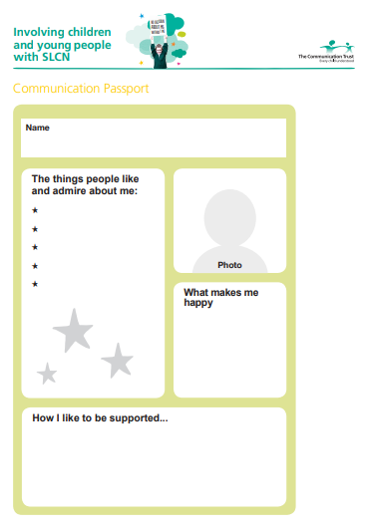
Primary
Pupil passports/profiles
Include:
Strengths / what people like or admire about the child
Interests / things they enjoy
Areas of need
Strategies that support them
Relevant professionals / interventions
https://www.thecommunicationtrust.org.uk/media/599128/communication_passport.pdf
Notes:
Having a pupil passport or profile for all children with SEND is good practice as it ensures useful information about the child is shared with all relevant professionals.
As a general guide, a pupil passport/profile should include information about the child’s:
Strengths
Interests/things they enjoy doing
Areas of need/where they need support
Strategies/teaching approaches that support them (e.g. using visuals, simple language, etc)
Environmental adaptations that support them
Additional interventions they access
Any relevant professionals/agencies involved in the child’s care
As children progress into KS2 and beyond, they can become involved in writing their own pupil passport/profile. This develops important skills in self-awareness and self-advocacy. Different formats for a passport/profile can be explored with the child, such as a PowerPoint presentation, or even a video recording of them talking about their strengths, needs and things that support them.
The example shown on this slide is quite a simple version from the Communication Trust. You can use this and fill it in, or just use it as inspiration and make your own. You can also explore different formats with the child, like having them design their own one page template, or even a PowerPoint presentation, or a video of them talking about themselves.

Slide 58
Secondary
Notes:
NOTE TO SENCOS: THE FOLLOWING SLIDES ARE AIMED AT SECONDARY SETTINGS. DELETE THESE IF WORKING IN A PRIMARY SETTING

Slide 59
What does “Universal” look like?
Universal
Secondary
We understand what DLD is and the impact it can have on learning and behaviour
We all use communication-supportive strategies all the time
Teaching supports the speech, language and communication skills of all young people
We have tools to identify young people who have speech, language and communication needs
Notes:
To have good universal provision for all young people, we need these things.
We all need to know what DLD is and why it’s important – and today is the start (but not the end!) of that.
We all need to be using communication supportive strategies all the time – we’ll talk about those in a minute.
We need to make sure that our teaching practices support the speech, language and communication skills of all young people.
We also need to make sure that we have tools to help us identify young people who are having difficulties, and who have possible DLD.

Slide 60
Some universal strategies
Secondary
Specialist
Targeted
Universal
Create a communication-supportive environment
Adapt your language
Explicitly teach vocabulary
Notes:
We’re going to talk about 3 key strategies that you can use at a universal level now

Slide 61
Universal
Secondary
Strategy 1: Create a communication-supportive environment
  Reduce background noise
  Plan and use visual supports
  Write down key information and instructions
  Reduce visual “noise”
  Time-table planning
Notes:
One way of supporting the speech, language and communication skills of all young people is to have a communication supportive environment. Some examples of how to do this are given on this slide.
Reduce background noise – this helps them attend to what you are saying without having to filter out additional noise. Can do this by closing doors and windows and ensuring only one person speaks at a time (adjust this based on policies/procedures in your setting).
Plan and use visual supports to supplement spoken instructions and explanations – written words, photographs, images, symbols, mind maps, diagrams and hands on demonstrations. More on next slide.
Write down key information and instructions at the front of the class. Highlight/underline/bold key words or put them in a different colour.
Reduce visual “noise” – having an environment that is too visually stimulating can be overwhelming for young people with DLD as they have to filter out distractions to focus and concentrate.
Finally a word in terms of timetable planning – it can help to have lower cognitive load activities or lessons first thing in the morning and later in the afternoon. The middle hours from 10-2pm are best for adolescents generally, according to research from Sarah Jane Blakemore (2018) – so it's best to put the most demanding stuff in the middle of the day if possible.

Slide 62
Universal
Secondary
Written words
Pictures
Diagrams
Demonstrations
Hands-on activities
Symbols
Natural gesture
Videos
Notes:
Using visual supports is really important – not just for young people with DLD. It means the message lasts longer – something permanent rather than speech which disappears as soon as we have said it.
Gives extra time for language processing.
Helps young people understand what we are saying – gives an extra cue.
Doesn’t have to be a picture – even just writing things down on the board, using different coloured pens, bold/underlining words can help.

Slide 63
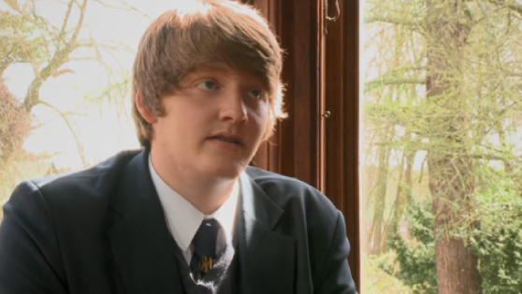
Universal
Secondary
Strategy 1: Create a communication-supportive environment
Video
https://www.youtube.com/watch?v=2yPR1UUtjec
Notes:
Now we are going to watch a video demonstrating some of these strategies.
While watching, think about the strategies they are talking about and reflect on which you are using already/which you could add to your teaching.
Watch video (2:52 mins) https://www.youtube.com/watch?v=2yPR1UUtjec

Slide 64
Universal
Secondary
Strategy 1: Create a communication-supportive environment
Activity
  Discuss in year groups/key stages:
    Which of these strategies are you using already?
    What could you adapt/add to your practice?
    How could you incorporate visuals into your teaching more?
Notes:
After video, split attendees into groups based on year group/key stage and discuss the strategies from the video and previous slides as a group (with 5 mins for each group to feed back a couple of key points from their discussion/what they are going to take forward at the end):
Which of these strategies are you using already?
What could you adapt/add to your practice?
How could you incorporate visuals into your teaching more?

Slide 65
Universal
Secondary
Strategy 2: Adapt your language
  Attract attention first – say their name
  Avoid inferential language
  Use familiar vocabulary and check for understanding of any new words
  Allow extra processing time
  Repeat key points and summarise at the end
Notes:
Attract attention first – agree a signal that indicates the need for whole class attention or for instructions to specific individuals. Say names before giving specific young people an instruction.
Avoid inferential language, hidden meanings, idioms and abstract terms when giving instructions. Use explicit language to ensure all young people understand what they need to do. Instead of saying things like “put on your thinking caps” or “let’s get the ball rolling” – think about how you can make your instructions really explicit to give all young people the best chance of understanding.
Use familiar vocabulary that you know young people will understand. Explicitly highlight when you have used a new or less familiar word, and check for understanding.
Allow extra processing time – pause between explaining key points and ideas, and don’t talk for too long at any one time. Chunk what you are saying so that you’re giving one main idea per sentence.
Repeat key points and summarise what you have said at the end. Repetition is good for all young people but especially those with DLD – this ensures that those who need it get an extra opportunity to hear and understand.

Slide 66
Strategy 3: Explicitly teach vocabulary
Universal
Secondary
Tier 2 vocabulary
Describe
Discuss
Explain
Summarise
Compare
Predict
Estimate
Evaluate
Explicitly teach topic and 'Tier 2' vocabulary
Review it often
Visual prompts and supports
Talk about meaning and link to other words they know
Teach how it sounds – what sound it begins with, number of syllables, words it sounds like
Teach prefixes (mis-, re-, dis-) and suffixes (-ing, -ship, -ment)
Teach comprehension strategies
Notes:
General principles for teaching vocabulary to benefit all young people
Vocab is part of every subject – even Maths, PE, music, art.
Explicitly teach topic vocabulary – at beginning of a new topic. And review it often – reuse and highlight words frequently.
It’s important to teach Tier 2 vocabulary – Tier 2 words are commonly used across a variety of subjects and yet often don’t receive as much attention as Tier 3 ‘topic’ vocabulary. Tier 2 words can often be found in the learning objectives that we use – e.g. explain, summarise, discuss – without which it’s difficult for young people to understand what they’re meant to be doing.
Visual prompts and supports – pictures, diagrams etc. Have key vocabulary on the walls around the class. Refer to it often – there is no point having it on the wall if you don’t refer to it.
Talk about meaning AND sounds
Meaning – link to other words they know
Sounds – explicitly talk about what sound it begins with, syllables, rhyming words.
You can make new words easier to understand and less daunting if you teach prefixes and suffixes – so young people can break words down and make them more familiar.
You can also teach young people to use these strategies themselves – like breaking the word down, or using context to work out the meanings of unfamiliar words.

Slide 67
Strategy 3: Explicitly teach vocabulary
Universal
Secondary
https://ican.org.uk/no-pens-day-wednesday/
Notes:
An example of a vocabulary teaching template, you can access this and other resources from the No Pens Day Wednesday section of I CAN website https://ican.org.uk/no-pens-day-wednesday/

Slide 68
Strategy 3: Explicitly teach vocabulary
Universal
Secondary
https://www.blacksheeppress.co.uk/product/secondary-talk-narrative-ks3-4/
Notes:
Similar idea from Black Sheep Press Secondary Talk Narrative – structure to use when learning about a new product

Slide 69
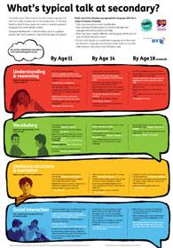
Identification tools
Secondary
Universal
Activity
https://ican.org.uk/media/2081/whats-typical-talk-at-secondary.pdf
Notes:
Whilst these universal, good, high quality teaching strategies will support young people’s speech, language and communication development, for those with DLD they are unlikely to be enough.
As you use these strategies in your teaching you will be able to spot which young people are struggling with speech, language and communication, but it can be hard to tell what area they are struggling with or how behind they are.
This is one example of a free identification tool that can be used to check a young person’s speech, language and communication development against what is expected for their age.
ACTIVITY: 5-10 mins
Use this link to open the poster in a separate window: https://ican.org.uk/media/2081/whats-typical-talk-at-secondary.pdf
Split participants into groups based on year group/key stage – participants to look at the relevant age group and consider whether the young people in their class are at this level. Do any of the norms surprise participants? Are there young people who are perhaps not where we’d expect them to be for their age?

Slide 70


Universal
Secondary
Identification tools
Activity
https://www.spelfabet.com.au/2014/01/language-for-learning-checklist
Class observation
Notes:
These are some other examples of tools that can be used to identify young people with speech, language and communication difficulties. The tools are not intended to be used to diagnose DLD, but they could give you an indication of children who may be struggling with their speech, language and communication skills, and who may need some extra support.
We just spent some time looking at the “What’s typical talk at secondary” poster.
Universally speaking is a similar tool – free to download, it gives an indication of what young people should be doing at different ages – you check your observations of young people against what’s expected for their age.
Progression tools – not free, but available across age ranges up to 18 – can help with identification but also provide a clear means of monitoring progress.
Talking point website- ages and stages section goes up to age 17. Lists what young people should be able to do in terms of their speech, language and communication at different ages.
I CAN have a free help line you can phone for advice – discuss concerns with speech and language therapist.
Language for learning checklists are freely downloadable behaviour checklists that you can use to guide your observations.
Finally, we can use our observation skills – but it’s important to keep a record of these – we can use this information if making a referral to speech and language therapy.
It’s important to be cautious when relying on observation only, because often young people with DLD may have developed strategies to help them cope in the classroom – e.g. they might be following their peers and copying what they do even though they don’t understand. So sometimes it might not look like language – but if you have concerns in some of the other areas that we have talked about, it might be worth using one of these other tools to check out their language.
Also we might have noticed from the last activity (What’s typical talk) that we aren’t always 100% aware of what young people should be doing at different ages – so it can help to have a tool to guide our observations.
ACTIVITY
Option 1: split into groups based on year group/key stage and talk about which of those observation tools you want to use in your class and how you will use them.
Option 2: discuss as a whole group which tools we want to use in our school and how we will use them.

Slide 71
Secondary
How do I raise concerns?
Discuss with tutor / head of year
Discuss with SENCo
Discuss with families & sensitive discussion with young person
Put targeted support in place – monitor progress
Refer to speech and language therapy
Notes:
NOTE: Reorder the first two points on this slide based on what the process is in your setting. Add any additional points as applicable.
Let’s say now that you have used an identification tool and you think a young person is presenting with some speech, language and communication difficulties. What next?
Discuss with tutor/head of year, see whether there are similar concerns, is there a history of concerns about speech, language and communication, etc.
Come and discuss it with SENCo to work out options – which targeted interventions are available, what additional support can be put in place.
Raise the issue with families – the Code of Practice states that families need to be informed and involved. This needs to be done sensitively
Some families may be unaware that their child’s speech, language or communication development is delayed – you may be the first person who raises this with them.
Some families may be at different stages of their acceptance of these needs.
You may need evidence to show families e.g. written observations, recordings etc
It’s also important to consider raising this with the young person. Self-awareness is really important – help them to recognise strengths and areas where they need support. Tutor/head of year may be the best person to work with the young person on this.
Trial putting some targeted support in place – e.g. intervention groups, extra support in class – and monitor progress. If no progress, then this may be a sign to refer on. You can include information about support in place already and observations in the referral.
Next would be referral to SaLT – specialist level. Let’s discuss targeted more first.

Slide 72
What does “targeted” look like?
Targeted
Secondary
We have additional interventions that have an evidence base and that we can deliver to small groups or individually
We have additional strategies that we can put in place in the classroom for young people who need them
We measure progress by collecting outcomes
Notes:
Support at the targeted level may include additional interventions – groups or 1:1 intervention programmes that we have on offer at our school (next slide).
May also include additional strategies that can be put in place in the classroom.
Important when putting targeted support in place that we measure how effective it is.
NOTE: may want to add any targeted interventions that you have on offer at your school to this slide.

Slide 73
Some targeted strategies
Secondary
Specialist
Targeted
Universal
Differentiate work and activities
Teach organisation and study skills
Social-emotional wellbeing and self-advocacy
Create a communication-supportive environment
Adapt your language
Explicitly teach vocabulary
Notes:
Will now look at 3 key targeted strategies.
Sometimes the difference between universal good, high quality teaching and targeted strategies are not always clear. The differences are in the amount of personalisation in the use of targeted approaches. The strategies discussed here should be matched closely to the needs of the individual young person as highlighted by the identification tool you have used. So for example if a young person has problems with putting ideas in order to tell a story, using a visual framework will help. It's also an important component of targeted strategies that you evaluate how they are working for the individual young person you are using them with, for example make a note of what conjunctions or sentence starters you provide and see if they begin to be used spontaneously in spoken and written formats – you can do this over a period of time.​

Slide 74
Strategy 1: Differentiate work and activities
Targeted
Secondary
Reduce number of tasks and amount of written information
Pre-teach vocabulary
Provide scaffolded versions of worksheets
Provide writing frames and templates for different genres of narrative
Help young people to organise their thoughts for written tasks
Give a sentence starter
Give a list of conjunctions
Differentiate homework tasks
Provide multiple options and scaffolding for young people to
demonstrate their learning
Notes:
Reduce the number of tasks that young people need to complete in the same time as others. A young person with DLD may need the same time to answer 2-3 comprehension questions that a peer needs to answer 6. They may also only be able to read a shorter passage of text in the same time as their peers due to their difficulties understanding and making sense of language.
Pre-teach vocabulary. Young people with DLD are likely to need many more exposures to learn new words (one study found that they need 36 exposures compared to 12 times for their typically developing peers, Storkel et al., 2017). Teach vocabulary to young people with DLD before the rest of the class – and revise the new words more often.
Provide young people with DLD scaffolded versions of worksheets where information is chunked and presented in small components, and images, diagrams and symbols are used to break up written information. Reduce the quantity of elements on one page where possible, and highlight/bold/underline key words and information for young people to focus on.
Provide writing frames and templates for different genres of narrative or written assignments to help young people with DLD when planning and structuring their ideas. Then at the sentence level, use cue cards such as colourful semantics symbols/prompts to help the young person think of different elements/word types.
Help young people with DLD at the planning stage of written tasks to organise their thoughts and work out where to start/what to do first. Some young people may benefit from having an adult scribe for them at this stage – write down everything they say about the topic initially, and then help them to look back and edit the vocabulary, sentence structure and grammar.
Give them a sentence starter (a few words to get them going) if they have trouble starting written work, e.g. “I think that…”, “I disagree with… because”.
Give them a list of conjunctions and ways they can be used to help extend their sentences when writing e.g. to continue the same point use words like “and”, “then”, “so”, “later”, “soon”. To disagree with a point use words like “but”, “however”, “except”.
Differentiate homework tasks – young people with DLD will find long paragraphs of written text and instructions overwhelming to read and will have little chance of success. Better to give them a more simple homework task that they can access, rather than a more complex task that they don’t complete at all.
Multiple options and scaffolding to demonstrate learning – think about if there are other ways young people can demonstrate what they have learned. E.g. a combination of talking/writing, supplementing written work with a drawing or demonstration, allowing them to pre-record oral presentations, using text to speech technology or vice versa, having a scribe.

Slide 75
Strategy 1: Differentiate work and activities
Targeted
Secondary
Support at the planning stage of written tasks
Provide visual structures/templates
Vocabulary lists – 'tier 2' words and topic vocabulary
https://www.blacksheeppress.co.uk/product/secondary-talk-narrative-ks3-4/
Notes:
You can support young people at the planning stage of written tasks by helping them to structure their ideas.
Giving visual structures or templates can really help, this example is a screengrab from a Black Sheep Press programme called Secondary Talk Narrative which has lots of templates like this for different genres of written narrative.
Its important to teach Tier 2 vocabulary - Tier 2 words are commonly used across a variety of subjects and yet often don’t receive as much attention as Tier 3 ‘topic’ vocabulary. Tier 2 words can often be found in the learning objectives that we use with young people – e.g. explain, summarise, discuss – without which it’s difficult for them to understand what they’re meant to be doing.
Providing young people with a vocabulary list may also help – think about Tier 2 words and topic vocab – this can help them to use these words in their own written work.

Slide 76
Strategy 1: Differentiate work and activities
Targeted
Secondary
https://www.blacksheeppress.co.uk/product/secondary-talk-narrative-ks3-4/
Notes:
Another example of a template from the Black Sheep Press Secondary Talk narrative programme

Slide 77
Targeted
Secondary
Blank’s levels of questioning
Level 4: Analysing & reasoning
How could we…?
Why…?
What will happen if…?
What will happen next?
Level 3: Stories and events
Tell me how to…
What is a… (definition)?
Level 2: More detailed here and now, describing things
Find something that is a mammal
What’s happening?
How are these different?
Find one like this
Level 1: Here and now
Where is X?
What’s that?
Who is it?
Notes:
Another way of differentiating work is by adjusting the complexity of the questions that you are asking young people.
One model of the hierarchy of questions – by Marion Blank – her research was with much younger children but some of her findings are still useful for Secondary staff to think about:
Level 1 questions relate to the here and now. Very simple, relate to things in immediate environment. E.g. what’s that, find one like this, who is it, where is X?
Level 2 questions are still about the here and now but are more detailed, more about describing things. E.g. what’s happening, find something that is a type of… , how are these different from each other?
Level 3 relates less to the here and now and is more about stories and events. E.g. tell me how to make a liquid, tell me what photosynthesis is (giving a definition), what might happen next?
Level 4 is the most complex, requires young people to analyse and reason. E.g. How could he do this/what could he do, what will happen if…, why is/isn’t…
If you are asking rest of class questions from level 4 for example, a young person with DLD might need questions from levels 2 and 3. Think about how complex the questions you are asking them are and what is realistic for them to answer.
Also adjust the number of questions that you expect them to respond to in the same time period as their peers.
References:
Blank, M. (2002).
Blank, M., Rose, S. A. & Berlin, L. J. (1978).
Blank, M. & Sheila, J. (1986).

Slide 78
Practise differentiating your questions
Targeted
Secondary
Activity
Level 4: Analysing & reasoning
Choose a text that you are currently reading or a paragraph on a current topic from your lessons
How could we…?
Why…?
What will happen if…?
What will happen next?
Level 3: Stories and events
Tell me how to…
What is a… (definition)?
Level 2: More detailed here and now, describing things
Find something that is a mammal
What’s happening?
How are these different?
Find one like this
Level 1: Here and now
Where is X?
What’s that?
Who is it?
Notes:
Split attendees into year groups/key stages
Ask attendees to come up with 3 questions for each Blank level based on a current text that they are using in class, or a paragraph related to a current topic. Or, they might like to refer back to a recent lesson (e.g. a science experiment) and think of a set of relevant questions related to that activity/lesson. It may help if participants can have the book/text/lesson plan in front of them to refer to.
Tell participants to start with Level 4 questions then work backwards – so that they are practising differentiating for young people at different levels.

Slide 79
Strategy 2: Teach organisation and study skills
Targeted
Secondary
Teach how to plan a study timetable
Explicitly teach revision skills
Teach prioritisation and time management skills
Teach young people how to use a homework planner
Teach vocabulary for exams
Teach how to write a task list and tick things off when done
Notes:
Explicitly teach skills such as reading a timetable, following the school map and learning the names of teachers and peers.
Support young people with DLD to plan a study timetable at exam times.
Explicitly teach revision skills such as writing notes, self-testing, making cue cards with topic vocabulary on one side and definitions on the other side, etc.
Explicitly teach prioritisation and time management skills to support young people with DLD when studying for exams and managing assignment deadlines.
Explicitly teach and remind young people how to use a homework planner to remember equipment for lessons and due dates for assignments.
Provide visual reminders of key revision techniques and strategies where possible.
Teach key vocabulary needed for written exams. Bear in mind that young people with DLD are likely to need many more exposures to learn new words.
Strategies like writing a task list and ticking things off when done can support independence and reduce reliance on adult support and direction.

Slide 80

Strategy 3: Social-emotional wellbeing and self-advocacy
Targeted
Secondary
  Build self-awareness
  Encourage them to say what helps them
  Plan ways for them to ask for help discreetly
  Have visual alternatives to ask for help
  Focus on strengths and build confidence with these
  Promote independence
  Teach vocabulary for emotions
  Build supportive and trusting relationships
Notes:
Build self-awareness – talk openly but in a sensitive way about the young person’s strengths and areas where they need help and encourage them to do the same.
Talk to young people about their DLD diagnosis and what it means for them.
Support and encourage young people to reflect on what helps them and to express this to others. What makes it easier for them to understand in lessons, to express themselves, and to complete their work? Do they find it easier when the teacher writes key points on the board / uses different colours/highlighters to emphasise key information / provides a vocabulary list with definitions of key terms?
Try out different strategies and ask the young person what works best for them. By collaborating with the young person with DLD, you are helping them to become more invested in their own learning and giving them a sense of control.
Plan ways for young people to ask for help discreetly – for example they could have a card on their desk that they can turn over if they need help.
Focus on strengths and build confidence with these – young people with DLD are going to find a lot of things hard in life, so it’s important for them to feel as though they are good at some things as well, and to know what those things are!
Promote independence by giving young people appropriate school roles and responsibilities using areas of strength.
Teach vocabulary for emotions so they can express how they are feeling and problem-solve with a trusted adult.
Be aware that using a talking approach for mental health support (e.g. talking therapies) will be difficult for these young people to access. Consider ways of adapting the approach using visual aids such as drawing, cartoons, rating scales, and checklists.
Build supportive and trusting relationships with peers and adults– this is important for all young people but even more for those with DLD who may be vulnerable and more at risk of mental health and social-emotional difficulties. Ensure that these young people have trusted adults they can talk to and go to for help, and friendships with peers who they trust.
Be aware that friendships in secondary school can be challenging for all young people, and even more so for those with DLD. They may need extra supported opportunities to build relationships with peers who have similar interests – such as through different clubs (e.g. chess club, drama club) or activities (e.g. school musical, sports, etc).

Slide 81
Targeted
Secondary
Targeted strategies
Activity
  Thinking about the targeted strategies we have just talked about:
    Which of these do you feel you use already?
    Which could you introduce into your practice?
Notes:
Split attendees into groups based on year group/key stage and discuss the following questions as a group (with 5 mins for each group to feed back a couple of key points from their discussion/what they are going to take forward at the end):
Which of the targeted strategies that we have just talked about do you feel you use already?
Which could you introduce into your practice?
Remember what we said earlier about the difference between universal good, high quality teaching and targeted strategies are. The differences are in the amount of personalisation in the use of targeted approaches. The strategies we have discussed should be matched closely to the needs of the individual young person as highlighted by the identification tool you have used. So for example if a young person has problems with organisation, teach some specific strategies to support with this, and make sure to measure the effectiveness of those strategies by collecting outcomes.

Slide 82
Specialist support
Secondary
Speech and language therapy
Specialist advisory teacher
Some young people may have an EHCP with funding (although many with DLD will not)
Specialist
Targeted
Universal
Differentiate work and activities
Teach organisation and study skills
Social-emotional wellbeing and self-advocacy
Create a communication-supportive environment
Adapt your language
Explicitly teach vocabulary
Notes:
NOTE: personalise this slide based on what specialist support you have available in your setting/local area

Slide 83
When to refer?
Specialist
Secondary
Young person’s language difficulties impact on access to curriculum
Family concerns
Universal and targeted strategies / interventions have been put in place – still concerns
Fast track:
    The young person’s speech is unintelligible
    The young person has a stammer (is dysfluent)
    Feeding or swallowing difficulties
Notes:
These are the instances when we would consider referring to speech and language therapy/for specialist support:
The young person’s speech and DLD are impacting on their ability to access the curriculum.
The family are concerned (bear in mind that this might not always be the case, for the reasons we discussed earlier).
We have tried universal strategies and targeted strategies/interventions, and have monitored progress, but concerns remain.
On the right hand side are some examples when you would fast track a referral:
You actually can’t understand the young person – their speech is unintelligible
They have a stammer – repeating whole words or parts of words
They have feeding or swallowing difficulties.

Slide 84
Specialist
Secondary
Referral
Information to include in a referral:
  Oral language
  Social interaction
  Behaviour
  Written language
  Can they follow a series of instructions
  How they retell a ‘story’
  How they generate and remember vocabulary
Notes:
These are the things we would want to include in a referral. So keep a note of your observations according to these areas.
Oral or spoken language – do they express themselves at the level of their peers?
Social – do they struggle to express themselves/keep up in social interactions?
Behaviour – could their behaviour be a sign of an underlying difficulty?
Written – are they showing evidence of difficulties with vocabulary and sentence structure?
Do they need instructions broken down? Repetition? Visual support? Do they follow what their peers do as a strategy to know what’s going on?
Do they have trouble sequencing events? Recounting something that has happened clearly so you can understand?
Is there any evidence of word-finding difficulties? Immature vocabulary? Difficulty remembering taught vocabulary?

Slide 85
Specialist
Secondary
Specialist support
  Speech and language therapy input may include:
    Assessment and diagnosis
    Develop and advise on strategies and therapy programmes
    Support with integrating strategies into classroom
    Coach families, teachers, teaching assistants in use of strategies
    Raise awareness and understanding of DLD
    May offer more support at different times e.g. transition
Notes:
NOTE: Adapt this slide based on what specialist support looks like in your setting/local area

Slide 86
Specialist
Secondary
Support at times of transition
  Practical tips:
    Model and practise using informal/formal language
    Role play life skills
    Discuss potential scenarios e.g. managing workload
    Help them to self-advocate
    Explicitly teach interview skills
    Be alert for signs that the young person may need support
    For more information: https://ican.org.uk/dld-webinar-series/
Between year groups
Between primary and secondary school
Between secondary and further / higher education or the workforce
Notes:
Periods of transition can be challenging for all young people but particularly for those with DLD.
Young people with DLD may be less able to engage in discussion about transition, to express how they are feeling, and to work through potential problems.
Transition between primary and secondary education is a big change and young people with DLD will need lots of support with this – they will have to cope with increased academic and language demands of the curriculum, as well as the social pressure of meeting new peers and forming friendships.
Then the transition between secondary and further or higher education or the workforce – suddenly, young people need to have skills such as being able to use different styles of language with colleagues as opposed to peers, knowing how to communicate independently at the GP or the dentist, and being able to organise their time independently.
Even the transition between year groups, while not as significant, is still difficult for some young people and needs to be prepared for.
Some practical tips are on this slide – if the young person is moving on to higher or further education or the workforce, we can role play situations where they will need to use formal or informal language.
We can also role play life skills, like visiting the GP, or making an appointment with the dentist, or ordering in a café.
As always, it’s important to be teaching skills in organisation and independence.
As young people transition to adulthood it’s hugely important that they are able to advocate for themselves – to talk about what’s hard for them and what helps them. So practising this with them is important – talk about what helps them and also what doesn’t help.
Remember that these young people are hugely vulnerable to mental health difficulties. Be on the lookout for signs that they may need support emotionally when going through a time of transition.
Young people might need specialist support at times of transition, even if they have been discharged before. We can re-refer to speech and language therapy services if we think this is the case.

Slide 87
Secondary
Pupil passports/profiles
Include:
Strengths / what people like or admire about the young person
Interests / things they enjoy
Areas of need
Strategies that support them
Relevant professionals / interventions
https://www.thecommunicationtrust.org.uk/media/599128/communication_passport.pdf
Notes:
Having a pupil passport or profile for all young people with SEN is good practice as it ensures useful information about them is shared with all relevant professionals.
As a general guide, a pupil passport/profile should include information about their:
Strengths
Interests/things they enjoy doing
Areas of need/where they need support
Strategies/teaching approaches that support them (e.g. using visuals, simple language, etc)
Environmental adaptations that support them
Additional interventions they access
Any relevant professionals/agencies involved in the young person’s care
It’s good practice to involve young people in writing their own pupil passport/profile. This develops important skills in self-awareness and self-advocacy. Different formats for a passport/profile can be explored with young people, such as a PowerPoint presentation, or even a video recording of the young person talking about their strengths, needs and things that support them.
The example shown on this slide is quite a simple version from the Communication Trust. You can use this and fill it in, or just use it as inspiration and make your own.

Slide 88
Secondary
First thing to implement
Activity
  Thinking about what we have covered today:
    What is the first thing you are going to change/add to your practice?
    When and how will you review how it has gone?
Notes:
Split attendees into groups based on year group/key stage and discuss the following questions as a group (with 5 mins for each group to feed back a couple of key points from their discussion/what they are going to take forward at the end):
What is the first thing you are going to change/add to your practice?
When and how will you review how well it has gone?

Slide 89
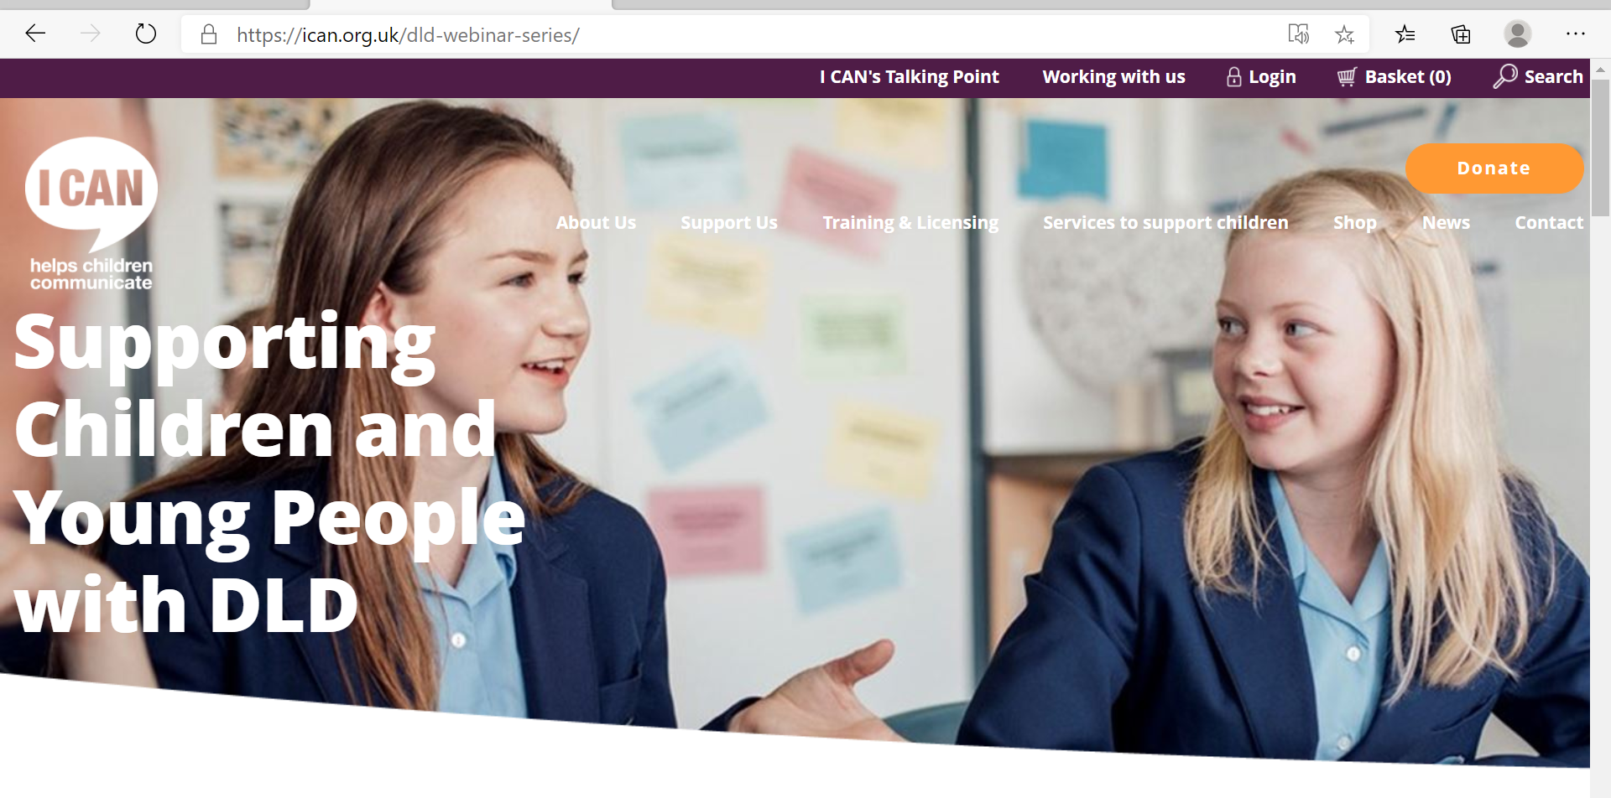
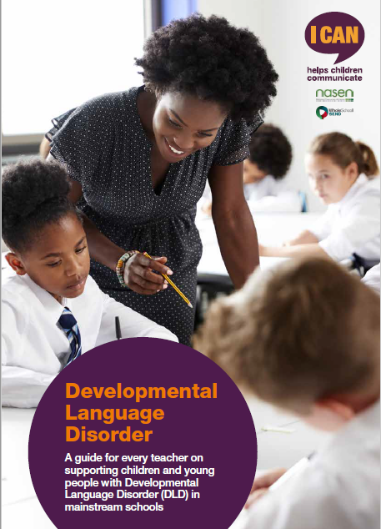
What next?
    For more information about DLD and how you can support CYP in your school, see:
    I CAN’s webinar series
    DLD guide
    Summary handout
https://ican.org.uk/dld-webinar-series/
www.sendgateway.org.uk/resources
Notes:
I CAN’s webinar series consists of a series of 8 webinars – 4 introductory level and 4 intermediate level – aimed at different school-based professionals – primary teachers, secondary teachers, SENCos, and senior leaders. They can be accessed via the link on this slide.
The DLD guide will be available via the same link and also on the SEND gateway. It’s a downloadable pdf that provides guidance to school staff in primary and secondary mainstream settings on what DLD is and how to support CYP with DLD in schools. It has more detail about all of the strategies we’ve discussed today plus some additional strategies that may be helpful.
Also don’t forget the summary handout that accompanies this presentation and has been provided as a pdf.

Slide 90
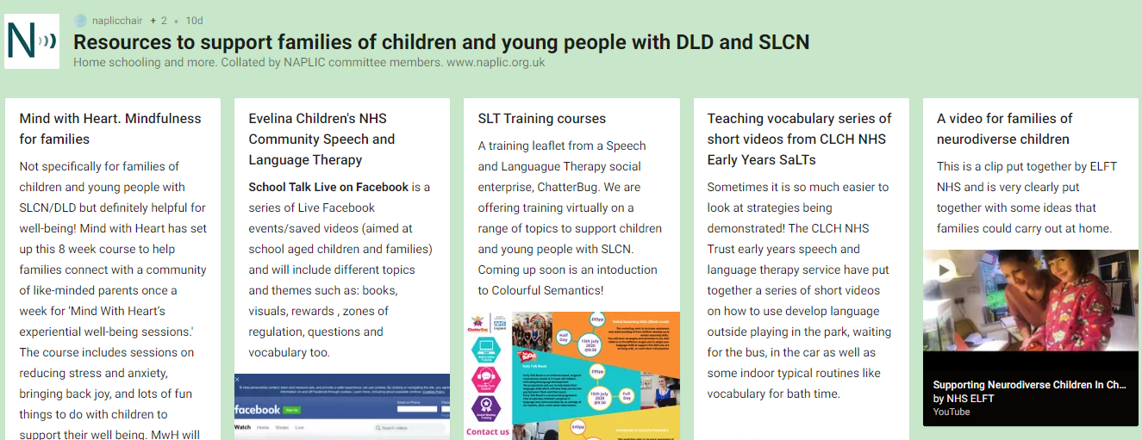
What next?
https://padlet.com/naplicchair/e83ts3jjjrw1?fbclid=IwAR2ec4cTwGC5Bi10vBe2r5VbJ4FvT3-6EOt8AWMH32EYKbxF68yZrkUBvtQ
Notes:
This padlet has been collated by NAPLIC and has links to a range of resources to support families of CYP with DLD and SLCN

Slide 91





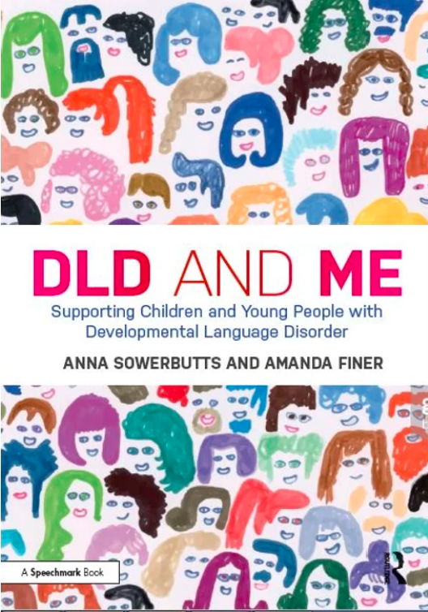

Additional resources and organisations
W | www.ican.org.uk
E | info@ican.org.uk
T | 0207 843 2510
dldandme.org
#devlangdis
dldandme.co.uk
Notes:
These are some organisations that we or families can contact for support, and there are also some resources on this slide
I CAN have a free help line that families or professionals can contact for advice – the 2544 number on this slide is the phone number for the help line. More general contact details for I CAN are below that – there is lots of information for families and professionals on their website
RADLD: a campaign to raise awareness of DLD – lots of videos online.
NAPLIC: UK organization of teachers, SaLTs and other professionals working with CYP with language difficulties.
RCSLT – royal college of speech and language therapists – has webpages with information on DLD.
Afasic – support for families
DLDandme.org: a website for raising awareness of DLD with support and resources
DLD and me book: written by 2 SaLTs, for SaLTS, teachers, other professionals, and families – 12 week self-awareness programme to help CYP identify their strengths, what supports them, and share it with others. Has been run in primary and secondary schools.
DLDandme.co.uk: Accompanying website for the book: website for kids and teenagers to learn about Developmental Language Disorder (DLD) and to share how they have told others. Also has a section for families and a section for teachers.
The DLD project is an Australian website but has lots of useful information for families and professionals including a podcast, links to Facebook support groups, and links to training
Twitter hashtag

Slide 92

Take the quiz! - Answers
DLD affects approximately what % of children in UK primary schools?
  ~1%
  ~5.4%
  ~7.6%
DLD is thought to be:
  Less prevalent than autism
  More prevalent than autism
  The same as autism in terms of prevalence
Approximately what % of children and young people with emotional and behavioural disorders have been found to have significant, often unidentified language difficulties?
  32%
  55%
  81%
Which of the below are possible indicators of DLD?
  Difficulty understanding language only
  Difficulty talking only
  Difficulty with talking and understanding
  Difficulty with literacy, reading comprehension and spoken language
  All of the above
Who can diagnose DLD?
  A teacher
  A SENCO
  A doctor
  An educational psychologist
  A speech and language therapist (SaLT)
Notes:
Let’s go through the answers from the quiz we did at the beginning

Slide 93
Appendix
Please choose from the following slides based on the actions you want to take forward in your setting
Notes:
Look at the appendix and add any slides next that you think are relevant for your school

Slide 94

Speech, Language and Communication Framework (SLCF)
Free online professional development tool
Self-assessment tool
Provides a personalised analysis for users
Plan CPD opportunities tailored to needs
https://www.slcframework.org.uk/the-speech-language-and-communication-framework-slcf/
Notes:
The Speech, Language and Communication Framework (SLCF) is a free online professional development tool that can be used by staff in the setting to check their own skills, knowledge and confidence in supporting SLC of children – then suggests areas you need to develop further and possible next steps like training courses, reading and resources.
It can be used by schools to help plan CPD opportunities tailored to the needs of staff.

Slide 95
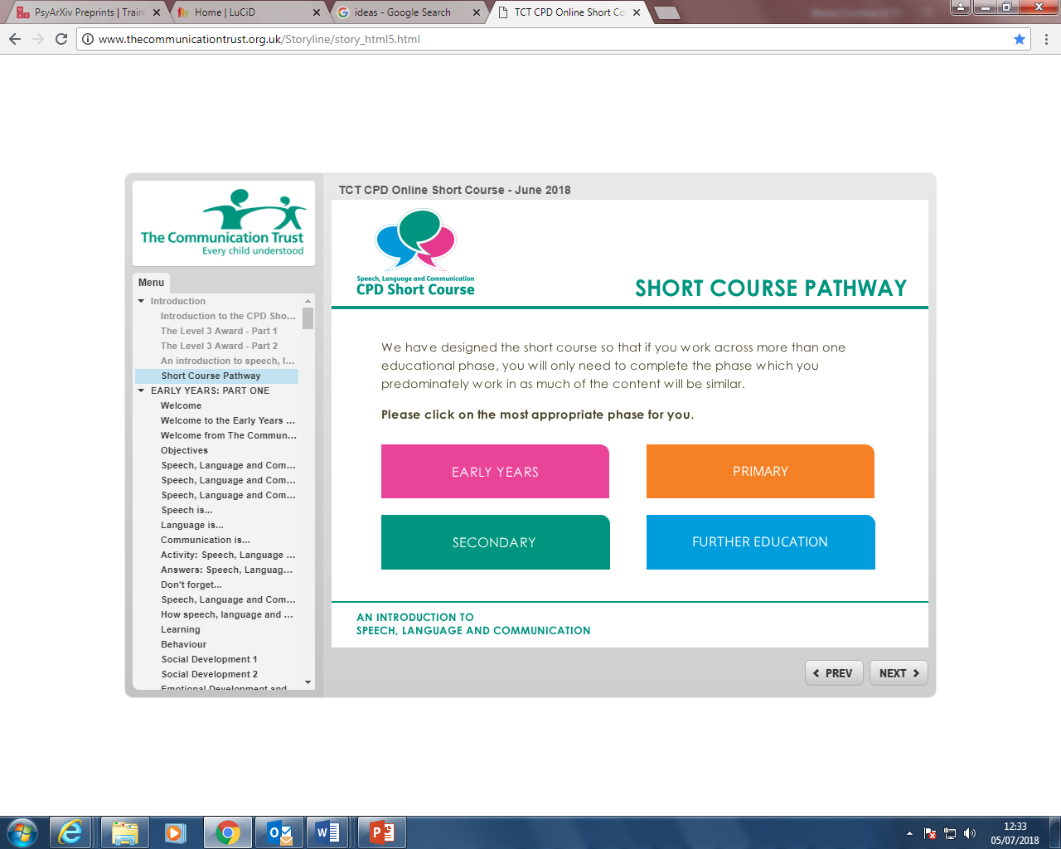
TCT Online Short Course
  Four parts:
  What do we mean by speech, language and communication and why are they such important skills?
  Understanding typical speech, language and communication development in children
  Strategies for supporting speech, language and communication
  Understanding and supporting children with SLCN
https://www.thecommunicationtrust.org.uk/projects/professional-development/online-short-course/
Notes:
TCT online short course is a course that could be done by teachers or TAs to build up their knowledge and understanding of SLC and SLCN.
It’s got 4 parts – definition of SLC and explaining why important, understanding typical development and milestones, strategies for supporting SLC, and how to support children with SLCN.
Some staff will need to do more than this – but this could be a good starting point.

Slide 96
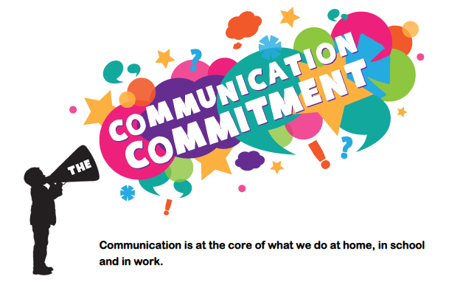
Communication Commitment
  Free resource
  Develop a whole-school approach to communication
  Action plan – information, toolkits, resources to support staff and involve school leadership
https://www.thecommunicationtrust.org.uk/projects/communication-commitment/
Notes:
The Communication Commitment is a free resource that can be used to develop a whole school approach to communication.

Slide 97



