Slide 1
Early Talk Boost
Overview
speechandlanguage.org.uk
Follow us @SpeechAndLangUK

Slide 2
Our vision, mission and charitable cause
Every child who is facing challenges with talking and understanding words can look to the future with confidence.
Our vision
Our mission
We give children and young people the skills they need so they aren’t left behind, waiting to be understood.
We do this by creating tools for schools and nurseries, giving advice and guidance to families and putting pressure on politicians.
Our charitable cause
For 1.7 million children in the UK, learning to talk and understand words feels like an impossible hurdle. Without the right help this can destroy their world.
Notes:
This is Speech and Language UK’s vision, mission and cause.

Slide 3
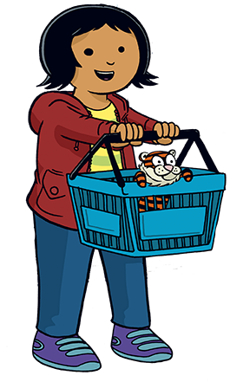
7 areas of learning and development
3 prime areas:
communication and language;
physical development; and
personal, social and emotional development
4 specific areas (through which the three prime areas are
strengthened and applied):
literacy;
mathematics;
understanding the world; and
expressive arts and design.
Notes:
Reminder of the context = EYFS framework
Prominence given to communication and language

Slide 4
Early Learning Goals
Communication and language
Listening and attention: children listen attentively in a range of situations. They listen to stories, accurately anticipating key events and respond to what they hear with relevant comments, questions or actions. They give their attention to what others say and respond appropriately, while engaged in another activity.
Understanding: children follow instructions involving several ideas or actions. They answer ‘how’ and ‘why’ questions about their experiences and in response to stories or events.
Speaking: children express themselves effectively, showing awareness of listeners’ needs. They use past, present and future forms accurately when talking about events that have happened or are to happen in the future. They develop their own narratives and explanations by connecting ideas or events.
Notes:
This is what children need to be able to do:

Slide 5
Link between social deprivation and language delay
Notes:
However we know that many children struggle with communication and language and particularly those from areas of deprivation:
From 3 large scale cohort studies

Slide 6
What is Early Talk Boost?
A language intervention designed for 3-4-year olds to boost their language skills.
Includes:
Parents are also involved in the programme
Intervention Manual
Set of eight story books
Toolkit of resources
Tracker

Slide 7
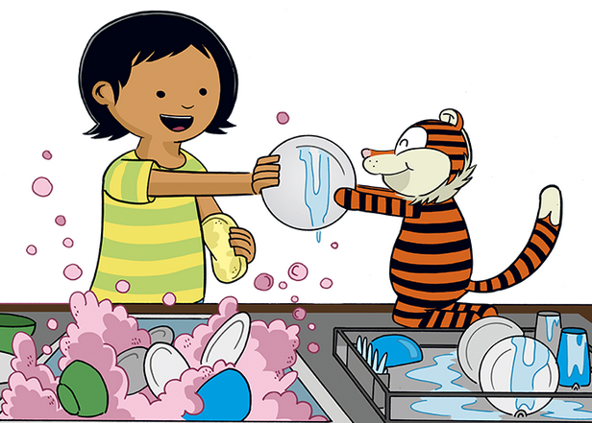
Early Talk Boost supports
Attention and listening
These are the foundation skills for speaking and listening.
Developing vocabulary
Research shows that children with weaker vocabularies are at risk of experiencing difficulties with reading.
Building sentences
Putting words together is a vital skill for having conversations and telling stories.

Slide 8
Jake & Tizzy story books
A series of eight story books introduce the characters of Jake and Tizzy, who are used throughout the intervention, so that children will become familiar with them. The books:
reinforce topics covered in the weekly sessions such as learning to listen, big and little, and action words
introduce and practise a range of vocabulary
focus on language structures required for building sentences.
Repeated reading of story books has an effect on children’s narrative skills and print knowledge (Horst et al, 2011).
Notes:
Horst, J., Parsons, K., and Bryan, M. (2011)'Get the story straight: contextual repetition promotes word learning from storybooks', Frontiers in Psychology www.frontiersin.org

Slide 9
Structure of each session: Plan, do and review
Planning/Introduction - using visual planning board
Talking about what you’ve done - using visual planning board
Activity 1
Activity 2
Song
Story featuring Jake and Tizzy
Notes:
EYPs trained to deliver the intervention

Slide 10
Overview of focus and content of intervention
 | Weeks | Topics
Attention and listening | 1 and 2 | Learning to Listen
Developing vocabulary | 3 and 4 | Food Big and Little
Building sentences | 5 to 8 | Action words On, under and in Three-key-word sentences First, next and last
Having conversations | 9 | Making friends

Slide 11
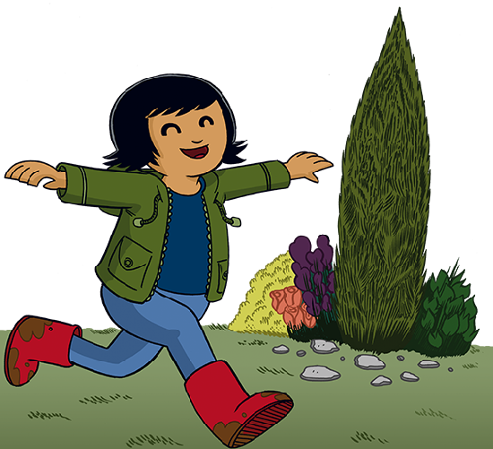
Early Talk Boost Tracker
The Tracker has four sections:
Attention and listening
Communication: Understanding of language
Communication: Speaking
Personal, social and emotional skills
Notes:
Notes
Look at the Early Talk Boost Tracker together and explain:
You’ll need some of the items from the Toolkit where you see the bag symbol.
You’ll need to use the pictures where you see the star picture.
You’ll also need to find the following things:
A cup
A spoon
A banana
A box with a lid.

Slide 12
Partnership with parents
All parents will have a copy of the eight weekly Jake & Tizzy story books to share at home.
Parents will be invited to attend a workshop on how sharing books can help language development.
These practical strategies will show parents what they can do to encourage their child’s talking.
Notes:
Discuss challenges of workshop – future plans

Slide 13
3 Pilot Areas – January 2015
Sunderland | 8 Nursery Settings
St Helens | 8 Nursery Settings
London Area | 7 Nursery Settings
Notes:
Randomly assigned to active and waiting control groups

Slide 14
Outcomes
EYPs
Knowing about / supporting SLC
Identifying SLCN
Having strategies to use
Children
improved language and communication skills
Parents
know how to support child’s SLC
Identify an improvement in child’s SLC

Slide 15
Evaluation Process
Assessment | Who administers | When
PLS- 4 | Evaluation Assistant | T1; T2; T3
Parent Rating Scale | Evaluation Assistant with parent | T1; T2; T3
Ferre Laevers checklist | Early Years practitioner | T1; T2
ETB Selection Tool | Early Years practitioner | T1; T2; T3
Child rating scale | Early Years practitioner
Staff Outcome Measures – (Questionnaire pre training and post intervention delivery) | Paper version - CA | T1; T2 Waiting and active settings
Quality audit parent training | Paper version – CA | Following parent training
Quality audit of staff training | Paper version - CA | Following staff training
Notes:
Evaluation Assistant = SLTs and students independent of Speech and Language UK and blind to which group the settings were in (i.e. whether children were doing the intervention or were comparisons)

Slide 16
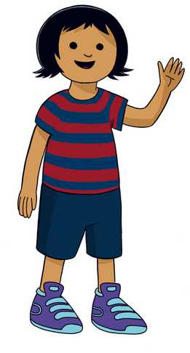
Initial Findings
After Early Talk Boost, children make statistically significant progress in their early language. On average they make 6 months progress after a nine week intervention helping them to catch up with other children their age. This is twice the amount of progress of children not having the intervention.

Slide 17
Parent’s rating of their child’s communication skills
Notes:
Parent questionnaire:
From the Active settings 48 questionnaires were completed (out of 87 children).
A return rate of 55%

Slide 18
Children’s Voice
Key summaries from child voice data
After the intervention:
28% more children said they were happy when they went to nursery.
42% more children said that they were good at talking with their friends.
27% more children said that they could listen when their teacher/keyworker was speaking.
80% children said that they were happy telling stories (60% before).
Numbers of children who felt sad about their communication skills in a number of areas decreased.
40% more children were able to complete the child voice questionnaire after the intervention.
Samples of children's speech showed an increase in MLU (the number of words they used) and complexity of sentence structure.

Slide 19
Staff Outcome Measures
The active settings completed their follow up outcome forms at Time 2 (after ETB) the control settings completed them at Time 3 (once they had had ETB).

Slide 20
How much does it cost?
Intervention Pack £500 includes Intervention Manual, Tool bag, 10 x 8 Jake and Tizzy Books, Participant Book and on-line Tracker
EYPP funding for just 2 eligible children attending nursery part time
Potential to reach 24 children in a school year (if run 3 times)

Slide 21
For more information….
Visit the website to find out more - https://speechandlanguage.org.uk/training-licensing/programmes-for-nurseries-and-schools/
To purchase Early Talk Boost through our shop - https://speechandlanguage.org.uk/shop-for-educators/
To register on the tracker - https://speechandlanguage.org.uk/training-licensing/programmes-tracker/
To contact Speech and Language UK
info@speechandlanguage.org.uk
020 7843 2515

