Slide 1
is back for 2024!
Your logo here
Notes:
NOTE FOR SCHOOL STAFF:
This presentation is intended as a template for you to customise for your school/setting.
It can be used in class or at a whole school assembly at the beginning of your No Pens Day to prepare pupils for the day.

Slide 2
What is No Pens Day?
Notes:
Ask children for ideas.

Slide 3
What is No Pens Day?
A day of…
No writing
No drawing
No pens
For the entire day!
So, what do we do all day?
Notes:
Ask children for ideas about what we might do if we can’t use pens all day.

Slide 4
Communication skills
No Pens Day is all about…
Communication skills
What are some different ways that we communicate?
Notes:
Children generate ideas about different ways we communicate. Ideas to talk through on next slide once children have generated answers.

Slide 5
Communication skills
Talking
Understanding
Tone of voice
Gestures/actions
Pointing
Listening
Facial expressions
Using pictures or a device to communicate
Notes:
Talk through the different examples of communication skills.

Slide 6
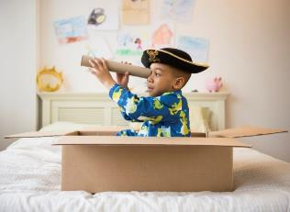
Communication skills are important for…
Reading
Doing maths
Playing
Joining in
Writing
Making friends
Talking about how you feel
Saying what you like and don’t like
Learning

Slide 7
Some children struggle with talking and understanding words
This is sometimes called “speech and language challenges”.
These children might find some things hard, like:
Talking
Listening
Understanding what to do
Making friends
Saying what they want or need
Talking about how they feel
Learning at school

Slide 8
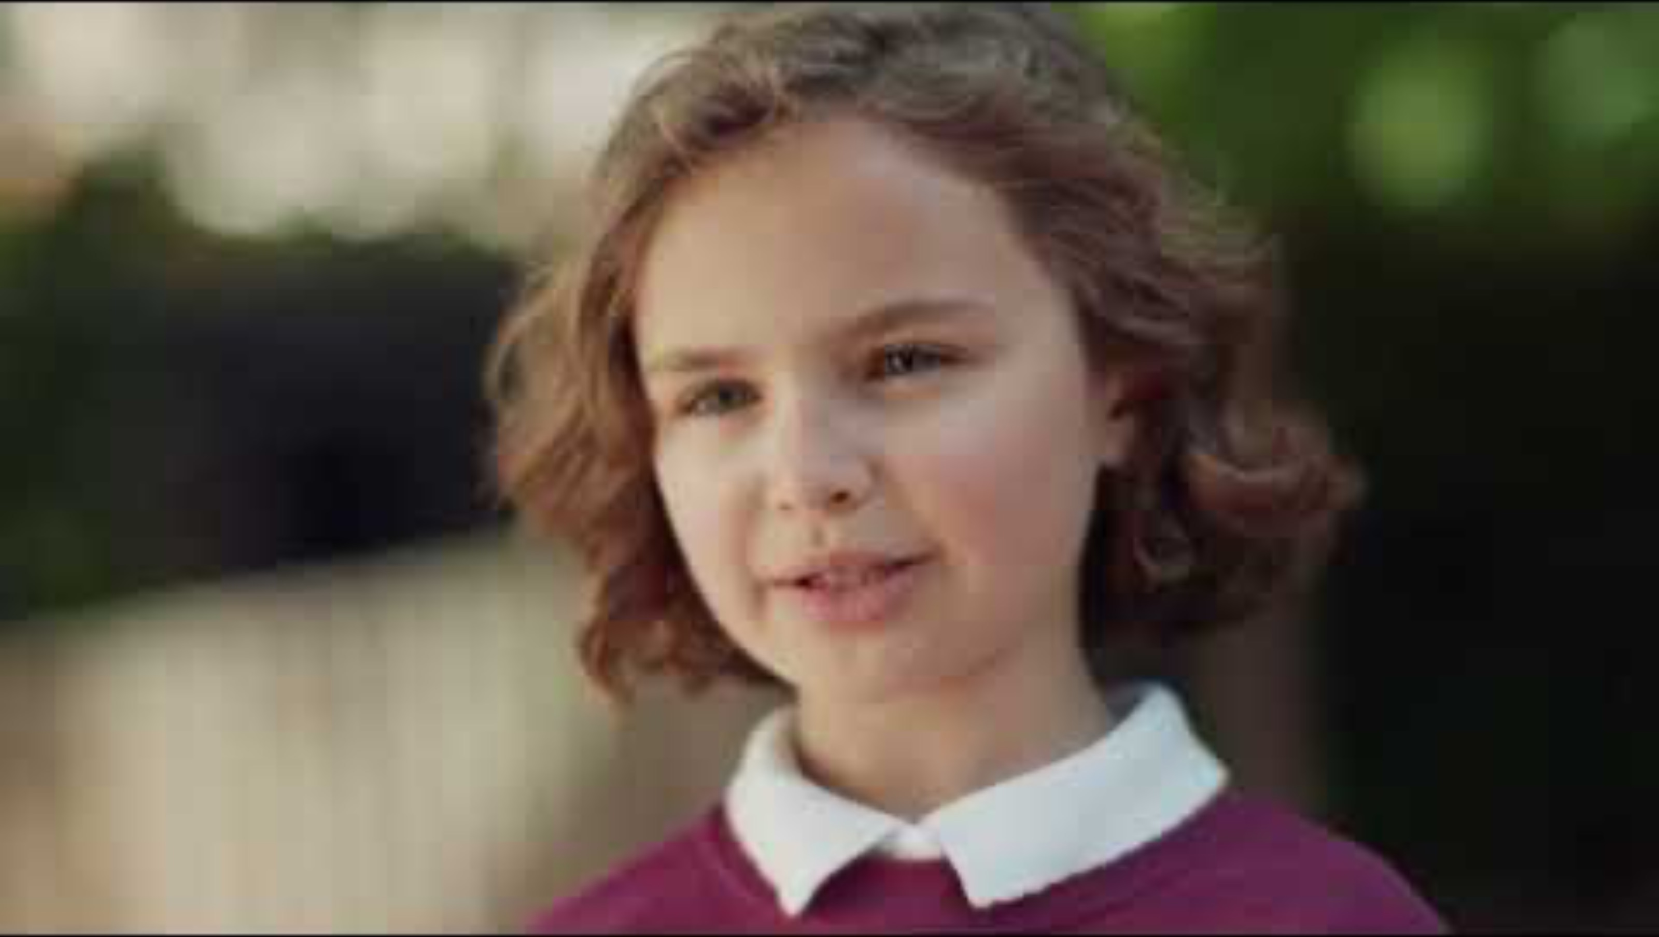
Darcie video
https://www.youtube.com/watch?v=38ur_bxJJG4
Notes:
Ask children to think about what Darcie finds hard.

Slide 9
We are helping children who struggle with talking and understanding words
Children who struggle with talking and understanding words
Notes:
No Pens Day is all about raising money to help children who struggle with talking and understanding words.
Most of you have paid £1 to take part in No Pens Day today. Your £1 helps other children who struggle with talking and understanding words.

Slide 10
Who are Speech and Language UK?
Our vision
Every child who is facing challenges with talking and understanding words can look to the future with confidence.
Our mission
We give children and young people the skills they need so they aren’t left behind, waiting to be understood.
We do this by creating tools for schools and nurseries, giving advice and guidance to families and putting pressure on politicians.
Notes:
A bit of information about Speech and Language UK on the next 2 slides – the organisation who work to support all children who struggle with talking and understanding words

Slide 11
Biggest ever Show and Tell!
Notes:
So, what are we going to do for our No Pens Day?
We are going to take part in the biggest ever show and tell!
Show and tell is a great way to practise communication skills.
You will be able to show your object that you have brought in from home to your class and you’ll be able to listen to your friends talk about their objects.
Lots of children all over the country will be doing Show and Tell today!
After Show and Tell, we’ll get to do some other fun activities with a focus on communication skills.

Slide 12
Have a great No Pens Day!
Remember:
No pens all day
Practise your best communication skills
Raise money to help children who struggle with talking and understanding words

