Slide 1
is back for 2024!
Your logo here
Notes:
NOTE FOR SCHOOL STAFF:
This presentation is intended as a template for you to customise for your school/setting.
It can be used at a staff briefing in the weeks leading up to No Pens Day to prepare staff for the day.

Slide 2
What is No Pens Day?
A day of…
No writing
No drawing
No pens
Run by Speech and Language UK.
Supports development of important communication skills in all children.
Raises money to support children who struggle with talking and understanding words.

Slide 3
Who are Speech and Language UK?
Our vision
Every child who is facing challenges with talking and understanding words can look to the future with confidence.
Our mission
We give children and young people the skills they need so they aren’t left behind, waiting to be understood.
We do this by creating tools for schools and nurseries, giving advice and guidance to families and putting pressure on politicians.
Notes:
A bit of information about Speech and Language UK on the next 2 slides – the organisation who work to support all children who struggle with talking and understanding words

Slide 4
What does Speech and Language UK do?
Push for policy change
Run two special schools
Design programmes
Provide training
Support families
Notes:
Some of the work that Speech and Language UK do:
They design innovative tools and training for thousands of nursery staff and teachers.
They give families the confidence and skills to help their child.
And they put pressure on politicians to prioritise support for children.
They have two special schools for children with complex speech and language challenges

Slide 5
1.9 million
children are struggling with talking and understanding words in the UK right now.
https://speechandlanguage.org.uk/listening-to-unheard-children/
Notes:
According to research from Speech and Language UK, there are currently 1.9 million children who are struggling with talking and understanding words in the UK.
This number is up from 1.7 million last year, and 1.5 million the year before – so the number is on the rise.
You can download the full report and read the results of the research at the link on this slide

Slide 6
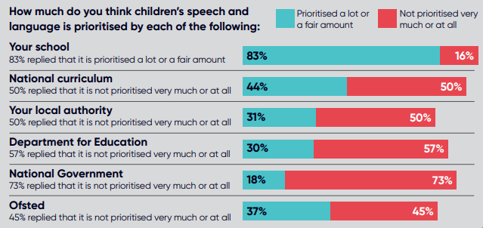
Listening to unheard children report
Notes:
Some more findings from their research on this slide.
1.9 million children equals 1 in 5 children in the UK who are struggling.

Slide 7
Without communication skills, children will struggle
To make friends
To learn
To have good mental health
To get a job
Notes:
There is lots of research about the impact of speech and language challenges.
Without these skills, children will struggle to make friends, learn, have good mental health, and ultimately, get a job.

Slide 8
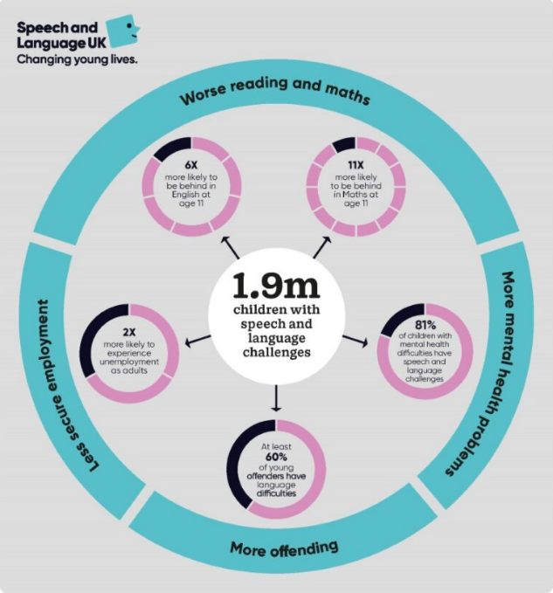
Consequences of speech and language challenges
Notes:
Worse literacy and numeracy: 6x more likely to behind in English at age 11, 11x more likely to be behind in Maths at age 11.
More mental health problems: 81% of children with mental health difficulties have speech and language challenges OR 4 in 5 children with mental health difficulties have speech and language challenges.
Increased risk of offending: At least 60% of young offenders have language difficulties.
Less secure employment: 2x more likely to experience unemployment as adults.
Low GCSE grades: only 15% gain a 9-5 pass at GCSE in English and Maths.
Being excluded from school: One NHS service found that 63% of children excluded from mainstream schools had speech, language and communication needs.

Slide 9
By taking part in No Pens Day, we can help raise money to support children who struggle with talking and understanding words
Children who struggle with talking and understanding words
Notes:
No Pens Day is all about raising money to help children who struggle with talking and understanding words.
Children pay £1 to take part in the ‘show and tell’ element of the day and this money goes to Speech and Language UK to help support children with speech and language challenges.

Slide 10
Biggest ever Show and Tell!
Notes:
So, what are we going to do for our No Pens Day?
We are going to take part in the biggest ever show and tell!
Show and tell is a great way to practise communication skills.
Children bring in an object from home and participate in a show and tell activity with their class.
Lots of children all over the country will be doing Show and Tell.
After Show and Tell, there’s a host of other activities on the Speech and Language UK website that we can choose to fill the rest of the day with.

Slide 11
What did schools who took part last year say?
“
“The best bit was the way the children talked to each about the reasons why we were taking part.”
93% said they would recommend No Pens Day to other teachers and colleagues
“Raised awareness of the importance of a rich language environment… some very creative activities explored and a very enjoyable giant show and tell.”
“It was nice for the quieter children who tend to shy away to have a chance to speak uninterrupted and show/talk about something they are interested in. Some new friendships are beginning and children have realised they have a shared interest.”
Notes:
Some quotes from last year’s No Pens Day survey.

Slide 12
Preparation for the day
Read through the how-to guide for teachers
Tell children to:
Bring something in from home to share for the biggest ever Show and Tell
Bring £1 to take part on the day
Print and send home the parent leaflet
All information and resources on the Speech and Language UK website: https://speechandlanguage.org.uk/get-involved/no-pens-day/

